Slide 1
Homeostasis
Notes:
What do you understand by this term?
“A dynamic steady state of the constituents in the internal fluid environment that surrounds and exchanges materials with the cells” Human Physiology Sherwood, 4th Ed, 2001

Slide 2
Homeostasis
“A dynamic steady state of the constituents in the internal fluid environment that surrounds and exchanges materials with the cells.
Human Physiology (4th Ed), Sherwood, 2001.

Slide 3
Homeostatic Control Mechanisms
Notes:
What are the 3 primary components of a biological control system?
Sensor
Integrator
Effector
What is the main integration centre?
Hypothalamus
Meaning of thalamus?
greek for “bed” or “bed chamber”. I was told in undergrad that the Greeks thought this was where your soul “slept”, but not sure if that’s apocryphal or not. So hypothalamus means “under the bed! I’m sure there are monsters hiding in our hypothalamus!
What are the main effector mechanisms?
Behavioural/voluntary
Autonomic outflow
Endocrine
A lot anaesthesia, and indeed Primary Exam questions, relate to how how it disrupts sensor and effector mechanisms. We need to implement our own sensing mechanisms (ie monitoring), we become the integrator, and and then institute effector mechanisms through mediations and other interventions.
Today’s tute is focussing on the endocrine aspect.
However important to remember that these effector mechanisms are all closely integrated and there is significant overlap, and if a disturbance is detected, then usually multiple effector mechanisms are utilised to try and correct it.

Slide 4
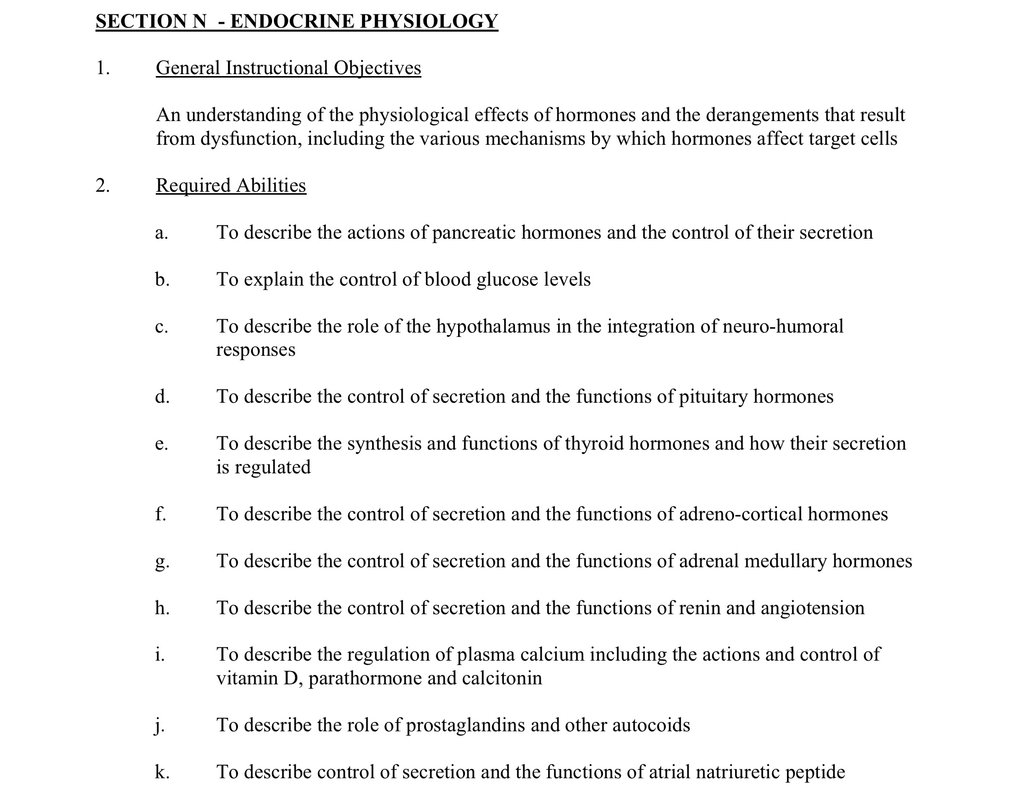

Slide 6
Endocrine Definition
Notes:
chemical messenger system consisting of
“hormones”
ductless glands
secreted directly into the circulatory system
distant target organs
What are the classes of hormones?
Peptides/Proteins
Amines (thyroid, catecholamines, derived from tyrosine)
Steroids
(eicosanoids-next slide)
Can also classify as Anabolic/Catabolic to some degree

Slide 7
Paracrine?
Autocrine?
Exocrine?
Notes:
Where do they find in?
?subset of endocrine
?immune
Not really a “system” as such
Exocrine should probably be considered seperate to endocrine-has ducts that that secrete outside the body.

Slide 8
Compare & contrast the nervous and endocrine systems.
Notes:
What about the adrenal gland? Endocrine or nervous system? How are the two systems integrated?
(NEXT SLIDE)
Ethernet vs Wifi
Neural:
Only a few cells receive signal and all can respond
Fast
Brief
Endocrine:
Many (all) cells receive signal but only a few can respond
Slow
Prolonged
Speed of transmission
Duration of response
Specificity of action?
Neural: close anatomical relationship to target cells, localised release of neurotransmitter.
Endocrine: specialisation of target cell receptors
Glands are a feature of endocrine (but also exocrine)
Nervous system may stimulate or inhibit release of hormones, and vice versa.
neuromodulators
Some messengers can act as hormone or neurotransmitter depending on where it’s released (adrenaline)
Both involve chemical messengers
Feedback loops
Respond to stimuli

Slide 9
Notes:
What about the adrenal gland? Endocrine or nervous system? How are the two systems integrated?
Ethernet vs Wifi
Neural:
Only a few cells receive signal and all can respond
Fast
Brief
External environment
Endocrine:
Many (all) cells receive signal but only a few can respond
Slow
Prolonged
Internal environment
Speed of transmission
Duration of response
Glands are a feature of endocrine (but also exocrine)
Nervous system may stimulate or inhibit release of hormones, and vice versa.
Both involve chemical messengers
Feedback loops
Respond to stimuli

Slide 10
Signal Transduction
Notes:
What types?
Tell me about G-proteins
What about Insulin?

Slide 11
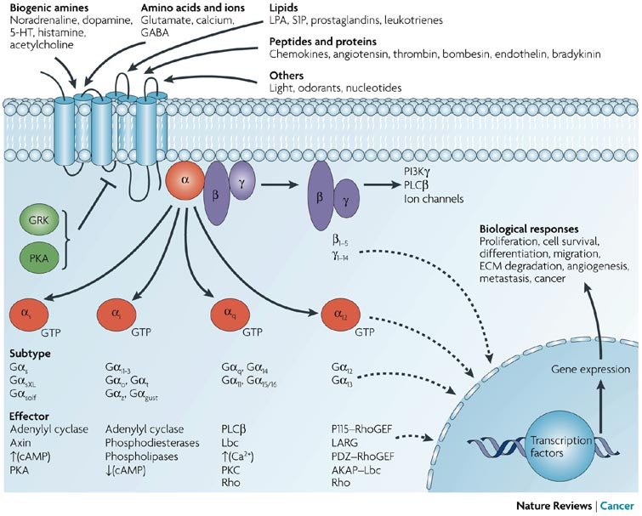
https://www.nature.com/articles/nrc2069/figures/1#f1
Notes:
https://www.nature.com/articles/nrc2069/figures/1#f1
What about insulin?

Slide 12
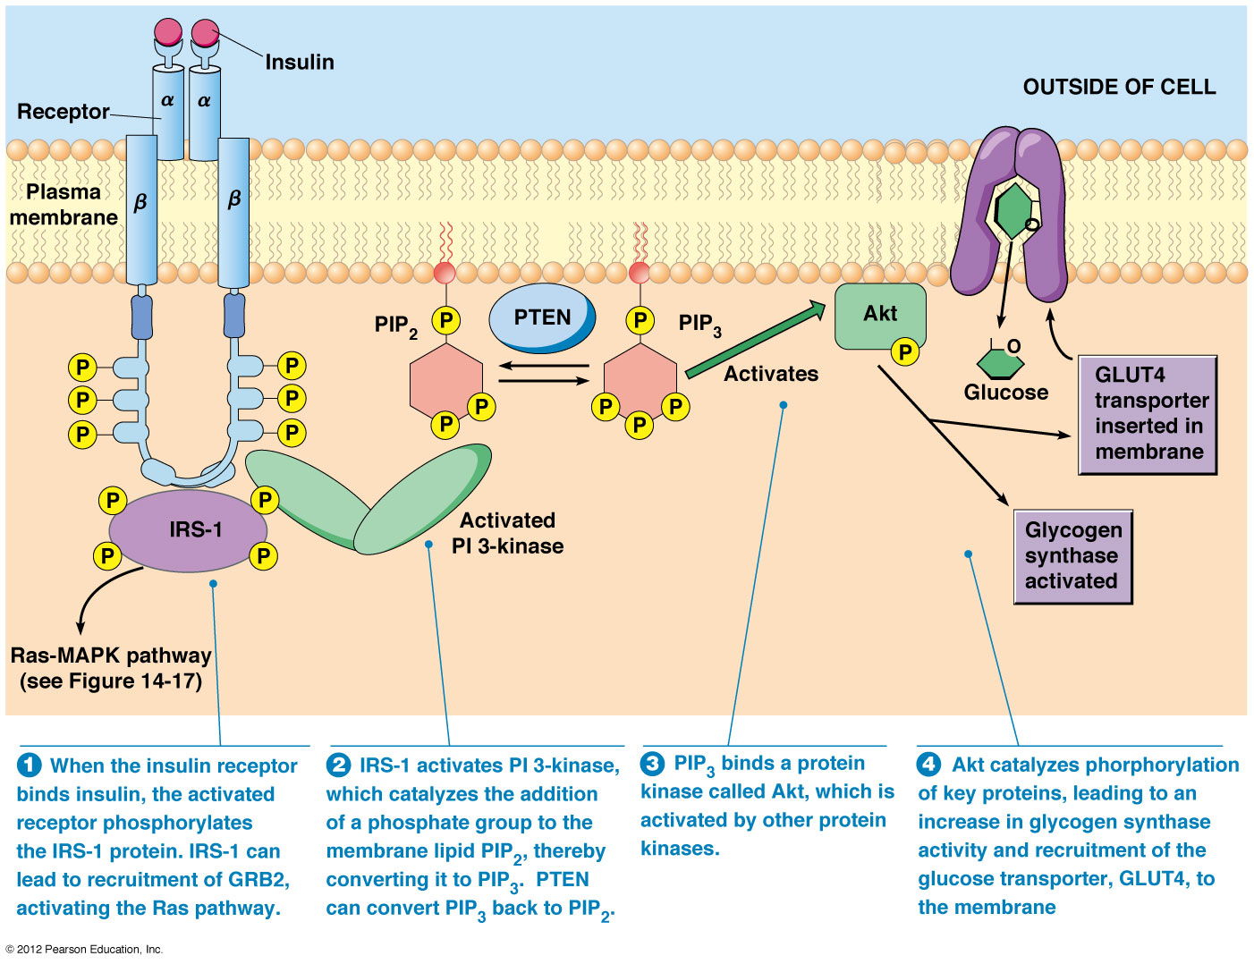
Notes:
Tyrosine kinase receptor
Auto-phosphorylation
Receptor/insulin complex internalised
and broken down or recycled
Steroid hormones?

Slide 13
Notes:
Steroid hormones (which includes thyroid hormones)
Receptor can be in cytosol or nucleus, but once bound to it’s ligand, it acts on DNA as a transcription factor.

Slide 14
Anatomy
Notes:
Many hormones involve multiple steps for activation and often take place in different organs.
HPA axis
Hypothalamus: TRH, CRH, GnRH etc etc
Pituitary
anterior: TSH, ACTH, FSH, LH, Prolactin
posterior: Vasopressin/ADH, Oxytocin
Adrenals
Cortex: Aldosterone (ZG), Cortisone, Androgens (ZF, ZR)
Medulla: Adrenaline, Noradrenaline
Pineal (Melatonin)
Thyroid: Thyroxine, Calcitonin
Parathyroid: PTH
Pancreas: Insulin, Glucagon, Somatostatin
Kidney: Renin, EPO
Skin: Vitamin D
Lungs: ACE
Liver: Somatomedins
Stomach: Gastrin
Small bowel: Secretin, cholecystokinin, GIP
Heart: ANP
Testes
Ovary/corpus luteum
Placenta
Uterus
Skeletal Tissue: osteocalcin
Adipose tissue: leptin, adiponectin

Slide 15
Notes:
Ganong
This slide is a good example of some of those principles of where the two systems interact, especially when you also consider the feedback loops for these messaging systems.
Which is the most important point of connection between the nervous & endocrine systems?
Hypothalamus
“head ganglion of autonomic system” (Sherington)
“meta-ganglion"
“Under the bed”
Stimulation does produce autonomic responses, but not concerned with regulation of visceral function per se. Rather, the autonomic responses triggered in the hypothalamus are part of more complex phenomena such as eating, and emotions such as rage.

Slide 17
Notes:
Ok, so what can you tell me about the pituitary, other than it looks like a scrotum?
Portal circulation (what is a portal circulation? What about kidney?)
“any part of the systemic circulation in which blood draining from the capillary bed of one structure flows through a larger vessel(s) to supply the capillary bed of another structure before returning to the heart”
begins and ends with capillaries without going through the heart
https://physoc.onlinelibrary.wiley.com/doi/pdf/10.1113/expphysiol.1978.sp002448
Peptide hormones
Anterior vs posterior
Embryology

Slide 18
Notes:
Ganong

Slide 19
Notes:
Ganong
Somatostatin/octreotide: GIH

Slide 20
Notes:
Ganong

Slide 21
Notes:
Ganong
The thyroid is also of interest to anaesthetists due to it’s location. Cricothyroid ligament.
Aside from Thyroid hormones, what else does the thyroid do?
Calcitonin

Slide 22
Describe the physiological actions of thyroid hormones.
Notes:
This is a past exam question
Doesn’t ask about synthesis, but we may as well run through it…
Describe the steps involved. Hypo-Pit-Thyroid-End organ
How is thyroxine synthesised?
T4, T3
Negative feedback loop.
The question asked the physiological actions of thyroid hormones, not the synthesis of thyroid hormones. There is a lot to cover by way of physiological actions. Some candidates spent time detailing their synthesis
Marks were awarded for noting the forms of thyroid hormones, the relative amounts in the bloodstream and relative activities. An account of their mechanism of action at a cellular level was considered important. An understanding of the implication of this mechanism of action to the time for onset of action and duration of effect scored extra marks.
An account of end-organ effects was present in some form in most answers, with a system by system approach often used. Most candidates were able to state that thyroid hormone increases metabolic rate. Many of these were able to go on to state that thyroid hormone had some catabolic effects. Some briefly mentioned the role of thyroid hormone in growth and development. Few picked up on the apparent contradiction between catabolic and anabolic effects, and described that the effects of thyroid hormones can be dose and age dependent. The effect of thyroid hormone to provide a negative feedback on its own synthesis was not often mentioned.
2003a(15): Describe the physiological actions of thyroid hormones General: Thyroid hormones include tri-iodothyonine (T3) and thyroxine (T4).
- Synthesised in thyroid gland within follicular cells
o Iodination of tyrosine residues in thyroglobulin backbone
o Synthesised hormones stored within thyroglobulin in colloid of
follicular cells
- Synthesis and release stimulated by TSH released from anterior pituitary
- TSH release stimulated by TRH released from median eminence of
hypothalamus via hypothalamic-hypophyseal portal system Release of T3 and T4
- TSH binds to receptors on cell membrane of follicular cells o GPCR → ↑cAMP → ↑adenylyl cyclase
- Effect of TSH:
o ↑I- uptake (active transport) into follicular cells → ↑Iodine trapping
o ↑synthesis of T3 and T4 via ↑iodination and ↑rate of coupling
reactions
o ↑proteolysis of thyroglobulin within follicular cells → liberate T3
(7%) and T4 (93%) for diffusion into circulation Physiological action of T3 and T4
Activity
- T3 and T4: highly protein bound (>99%)
o Bound predominantly to thyroxine binding globulin (TBG),
- t albumin, thyroxine binding pre-albumin (TBPA)
1⁄2 o T3:24hr
o T4:7days
- T3 is 3-5 x more active than T4 Effects:
- Cellular Effect:
o T4 is de-iodinated to T3 → binds intracellular receptors
- BMR:
▪ ↑gene transcription → ↑protein synthesis, ↑mt activity (↑size, ↑numbers) →→ ↑cellular activity
o ↑Metabolic rate of cells
▪ Excess T3/T4 → ↑BMR by 60-100%
▪ ?2° ↑stimulation Na+/K+ ATPase → ↑Na+ and K+ transport
through cells
o ↑appetite / food intake
- ↑CHO Metabolism (T4 and T3): o ↑absorption from GIT
o ↑glycolysis, ↑cellular uptake, ↑gluconeogenesis
- ↑fat metabolism (1° T4)
o ↑FFA release from adipose tissue
o ↓plasma cholesterol, ↓plasma triglycerides, ↓phospholipids
- Protein metabolism (T3 and T4) / muscles
o Physiological amounts: Anabolic (↑protein synthesis) By Amanda Diaz
Endocrine & Metabolism
o Excess amounts: Catabolic (↑muscle breakdown)
▪ Excess: fine tremour 2° ↑excitability of spinal cord
- CNS:
o Intra-uterine and neonatal brain development dependent on thyroid
hormones
▪ Deficiency: Mental retardation
o Sexual function 2° direct gonadal effect and indirect negative feedback on anterior pituitary control of sexual hormones
▪ Deficiency: ♂ → ↓libido
▪ Excess: ♂ → erectile dysfunction
- Bones:
o T4 important in regulating bone growth
- CVS:
o Direct: Positively chronotropic and ionotropic
o Indirect (2° ↑BMR): ↑systemic blood flow → ↑CO
o Nil effect on MAP (balanced by vasodilation (↓diastolic))
▪ Excess: tachycardia, AF
- Resp:
o Indirect (2° ↑BMR): ↑metabolic demand → ↑depth / rate respiration
- Thyroid Function:
o Negative feedback (free thyroid hormones) on hypothalamus (inhibit TRH release) and anterior pituitary (inhibit TSH release)
By Amanda Diaz
Endocrine & Metabolism

Slide 23
https://commons.wikimedia.org/wiki/File:Thyroid_hormone_synthesis.png
Notes:
https://commons.wikimedia.org/wiki/File:Thyroid_hormone_synthesis.png
Ok, so what are physiological actions?
The question asked the physiological actions of thyroid hormones, not the synthesis of thyroid hormones. There is a lot to cover by way of physiological actions. Some candidates spent time detailing their synthesis
Marks were awarded for noting the forms of thyroid hormones, the relative amounts in the bloodstream and relative activities. An account of their mechanism of action at a cellular level was considered important. An understanding of the implication of this mechanism of action to the time for onset of action and duration of effect scored extra marks.
An account of end-organ effects was present in some form in most answers, with a system by system approach often used. Most candidates were able to state that thyroid hormone increases metabolic rate. Many of these were able to go on to state that thyroid hormone had some catabolic effects. Some briefly mentioned the role of thyroid hormone in growth and development. Few picked up on the apparent contradiction between catabolic and anabolic effects, and described that the effects of thyroid hormones can be dose and age dependent. The effect of thyroid hormone to provide a negative feedback on its own synthesis was not often mentioned.
2003a(15): Describe the physiological actions of thyroid hormones General: Thyroid hormones include tri-iodothyonine (T3) and thyroxine (T4).
- Synthesised in thyroid gland within follicular cells
o Iodination of tyrosine residues in thyroglobulin backbone
o Synthesised hormones stored within thyroglobulin in colloid of
follicular cells
- Synthesis and release stimulated by TSH released from anterior pituitary
- TSH release stimulated by TRH released from median eminence of
hypothalamus via hypothalamic-hypophyseal portal system Release of T3 and T4
- TSH binds to receptors on cell membrane of follicular cells o GPCR → ↑cAMP → ↑adenylyl cyclase
- Effect of TSH:
o ↑I- uptake (active transport) into follicular cells → ↑Iodine trapping
o ↑synthesis of T3 and T4 via ↑iodination and ↑rate of coupling
reactions
o ↑proteolysis of thyroglobulin within follicular cells → liberate T3
(7%) and T4 (93%) for diffusion into circulation Physiological action of T3 and T4
Activity
- T3 and T4: highly protein bound (>99%)
o Bound predominantly to thyroxine binding globulin (TBG),
- t albumin, thyroxine binding pre-albumin (TBPA)
1⁄2 o T3:24hr
o T4:7days
- T3 is 3-5 x more active than T4 Effects:
- Cellular Effect:
o T4 is de-iodinated to T3 → binds intracellular receptors
- BMR:
▪ ↑gene transcription → ↑protein synthesis, ↑mt activity (↑size, ↑numbers) →→ ↑cellular activity
o ↑Metabolic rate of cells
▪ Excess T3/T4 → ↑BMR by 60-100%
▪ ?2° ↑stimulation Na+/K+ ATPase → ↑Na+ and K+ transport
through cells
o ↑appetite / food intake
- ↑CHO Metabolism (T4 and T3): o ↑absorption from GIT
o ↑glycolysis, ↑cellular uptake, ↑gluconeogenesis
- ↑fat metabolism (1° T4)
o ↑FFA release from adipose tissue
o ↓plasma cholesterol, ↓plasma triglycerides, ↓phospholipids
- Protein metabolism (T3 and T4) / muscles
o Physiological amounts: Anabolic (↑protein synthesis) By Amanda Diaz
Endocrine & Metabolism
o Excess amounts: Catabolic (↑muscle breakdown)
▪ Excess: fine tremour 2° ↑excitability of spinal cord
- CNS:
o Intra-uterine and neonatal brain development dependent on thyroid
hormones
▪ Deficiency: Mental retardation
o Sexual function 2° direct gonadal effect and indirect negative feedback on anterior pituitary control of sexual hormones
▪ Deficiency: ♂ → ↓libido
▪ Excess: ♂ → erectile dysfunction
- Bones:
o T4 important in regulating bone growth
- CVS:
o Direct: Positively chronotropic and ionotropic
o Indirect (2° ↑BMR): ↑systemic blood flow → ↑CO
o Nil effect on MAP (balanced by vasodilation (↓diastolic))
▪ Excess: tachycardia, AF
- Resp:
o Indirect (2° ↑BMR): ↑metabolic demand → ↑depth / rate respiration
- Thyroid Function:
o Negative feedback (free thyroid hormones) on hypothalamus (inhibit TRH release) and anterior pituitary (inhibit TSH release)
By Amanda Diaz
Endocrine & Metabolism

Slide 24
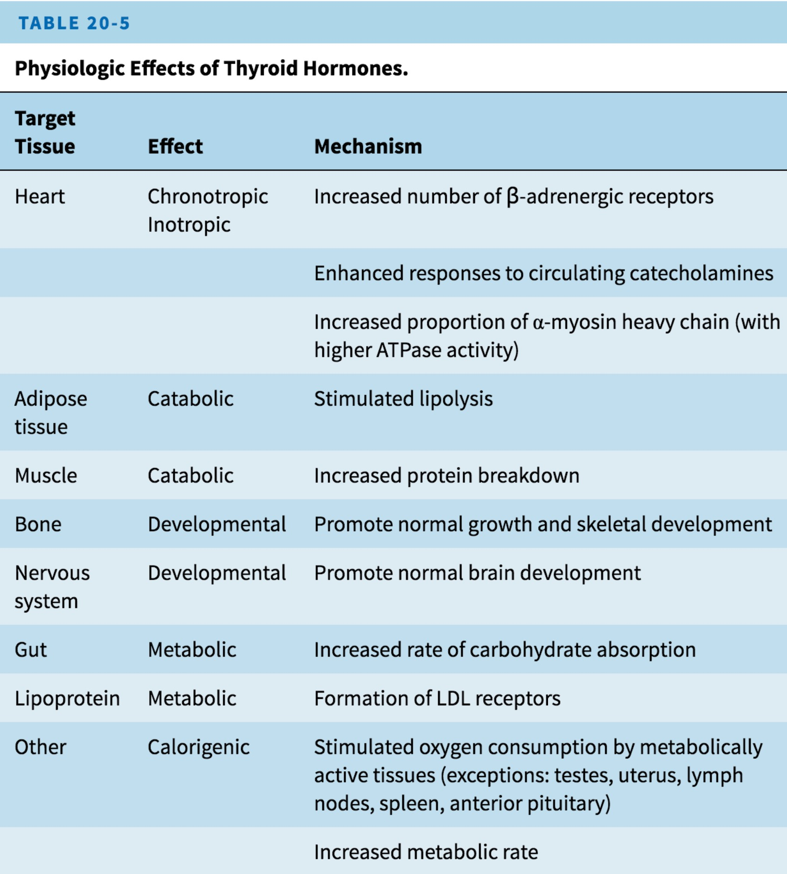
Notes:
Ganong

Slide 25
Katzung
Notes:
What’s this molecule? Where is it produced?
Katzung

Slide 26
Endocrine Pancreas
Notes:
What can you tell me?

Slide 27
Notes:
The presence in the pancreatic islets of hormones that affect the secretion of other islet hormones suggests that the islets function as secretory units in the regulation of nutrient homeostasis. Somatostatin inhibits the secretion of insulin, glucagon, and pancreatic polypeptide (Figure 21-16); insulin inhibits the secretion of glucagon; and glucagon stimulates the secretion of insulin and somatostatin. As noted above, A and D cells and pancreatic polypeptide-secreting cells are generally located around the periphery of the islets, with the B cells in the center. There are clearly two types of islets, glucagon-rich islets and pancreatic polypeptide-rich islets, but the functional significance of this separation is not known. The islet cell hormones released into the ECF probably diffuse to other islet cells and influence their function (paracrine communication; see Chapter 26). It has been demonstrated that gap junctions are present between A, B, and D cells and that these permit the passage of ions and other small molecules from one cell to another, which could coordinate their secretory functions.

Slide 28
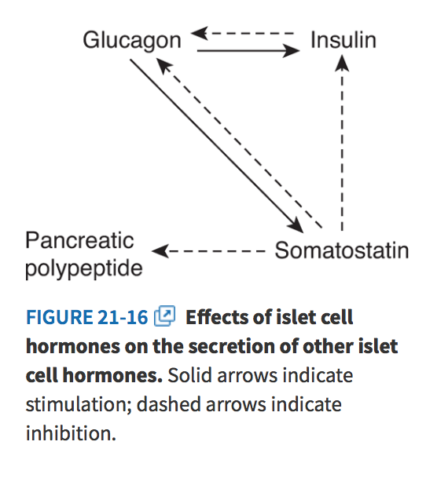
Notes:
The presence in the pancreatic islets of hormones that affect the secretion of other islet hormones suggests that the islets function as secretory units in the regulation of nutrient homeostasis. Somatostatin inhibits the secretion of insulin, glucagon, and pancreatic polypeptide (Figure 21-16); insulin inhibits the secretion of glucagon; and glucagon stimulates the secretion of insulin and somatostatin. As noted above, A and D cells and pancreatic polypeptide-secreting cells are generally located around the periphery of the islets, with the B cells in the center. There are clearly two types of islets, glucagon-rich islets and pancreatic polypeptide-rich islets, but the functional significance of this separation is not known. The islet cell hormones released into the ECF probably diffuse to other islet cells and influence their function (paracrine communication; see Chapter 26). It has been demonstrated that gap junctions are present between A, B, and D cells and that these permit the passage of ions and other small molecules from one cell to another, which could coordinate their secretory functions.

Slide 29
Katzung
Notes:
Katzung
What are the main actions of insulin?
How does the glucose sensor in B-cells work?

Slide 30
Notes:
Ganong
NEXT SLIDE: How does the glucose sensor in B cells work?

Slide 31
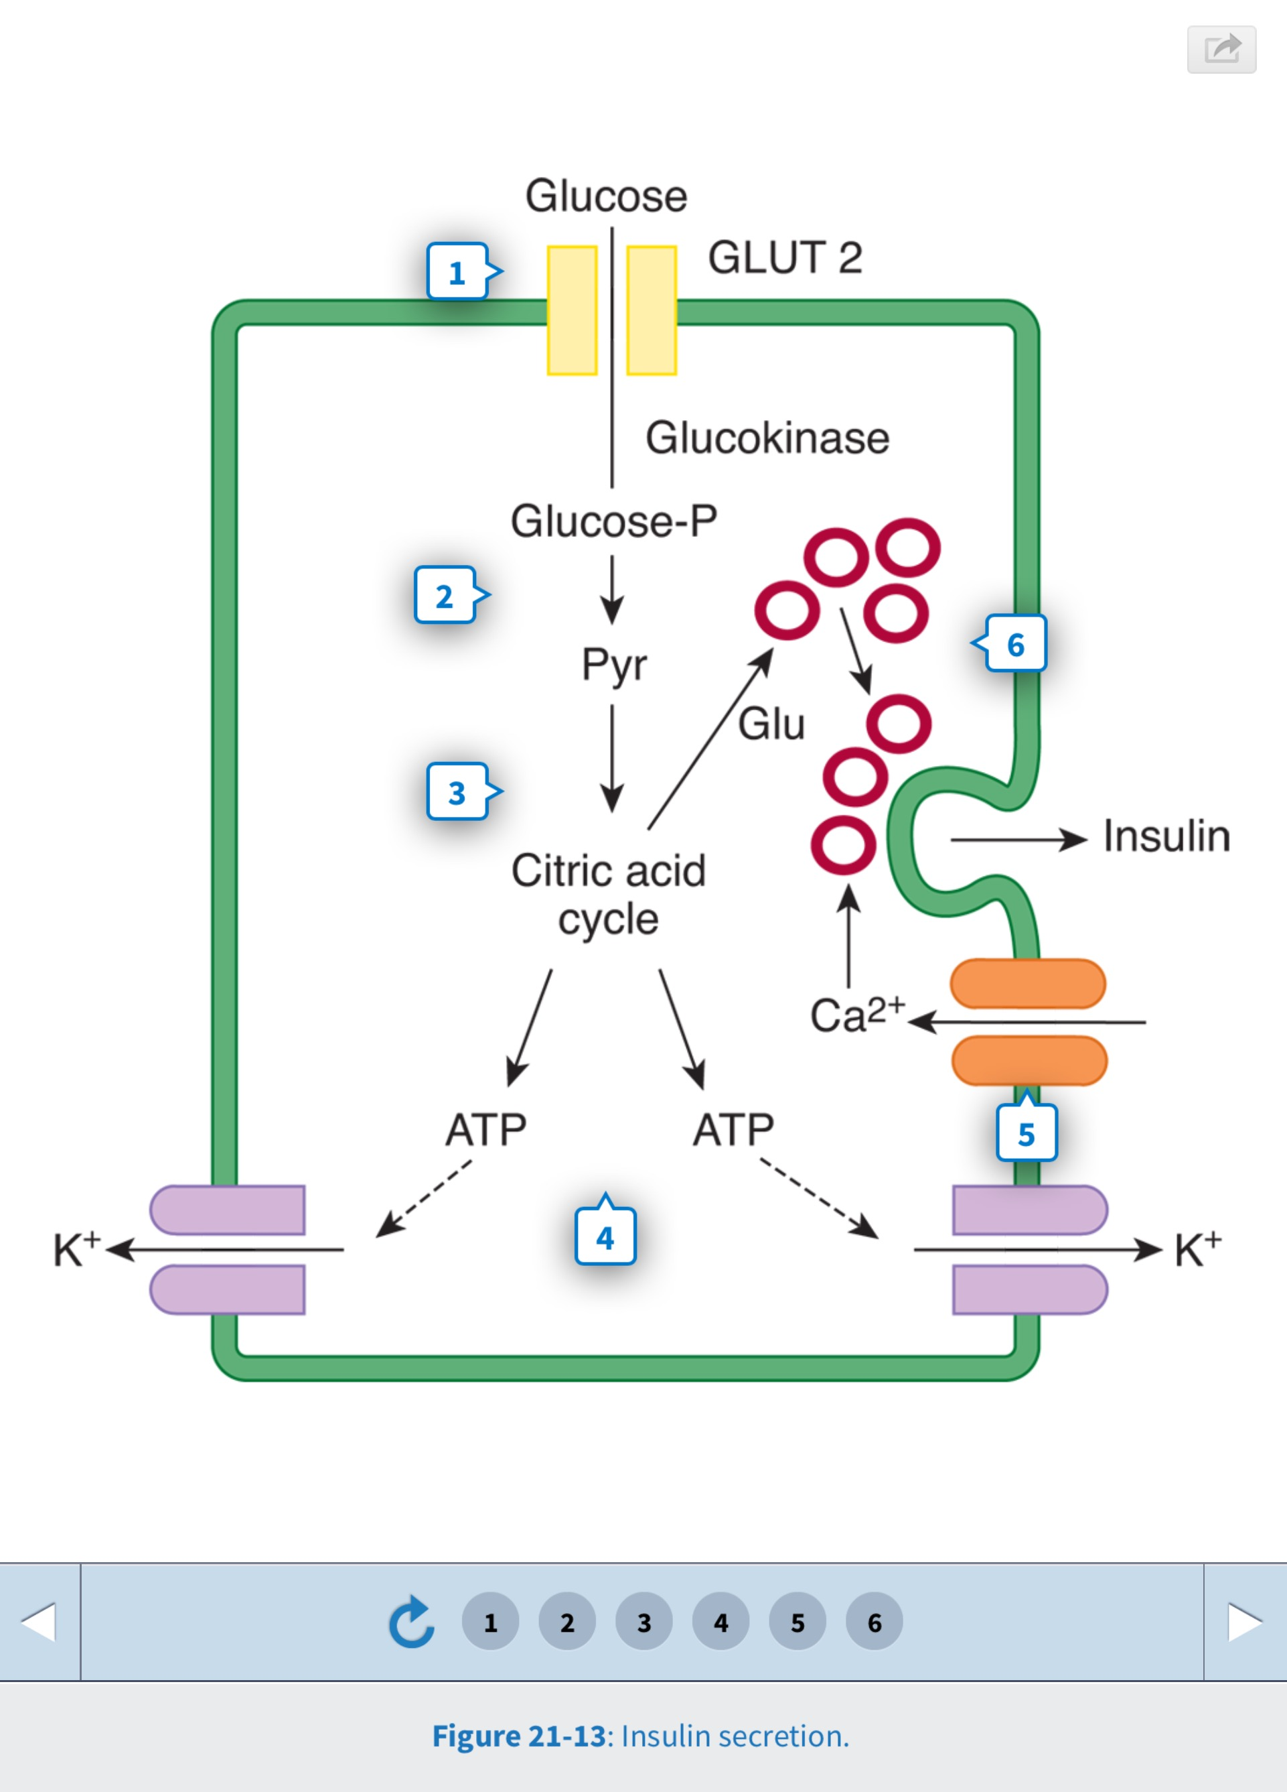
Notes:
Ganong
Glucose enters via GLUT-2
Km = 12-20 mM
Therefore rate of influx dependent on extracellular concentration over the physiological, and even diabetic, range
Phophorylated by glucokinase
Glycolysis
Krebs cycle & oxidative phosphorylation
Increased ATP
Inhibits ATP sensitive K+ channels
What will happen now?
Resting membrane potential & nernst-goldman etc
Depolarisation, influx of Ca2+, exocytosis
Pyruvate from Krebs also increases glutamate which primes another lot of insulin vesicles for section
Biphasic release of insulin
It has been known for many years that glucose acts directly on pancreatic B cells to increase insulin secretion. The response to glucose is biphasic; there is a rapid but short-lived increase in secretion followed by a more slowly developing prolonged increase (Figure 21-12).
FIGURE 21-13 Insulin secretion. Glucose enters B cells by GLUT 2 transporters. It is phosphorylated and metabolized to pyruvate (Pyr) in the cytoplasm. The Pyr enters the mitochondria and is metabolized via the citric acid cycle. The ATP formed by oxidative phosphorylation inhibits ATP-sensitive K+ channels, reducing K+ efflux. This depolarizes the B cell, and Ca2+ influx is increased. The Ca2+ stimulates release of insulin by exocytosis. Glutamate (Glu) is also formed, and this primes secretory granules, preparing them for exocytosis.
Glucose enters the B cells via GLUT 2 transporters and is phosphorylated by glucokinase then metabolized to pyruvate in the cytoplasm (Figure 21-13). The pyruvate enters the mitochondria and is metabolized to CO2and H2O via the citric acid cycle with the formation of ATP by oxidative phosphorylation. The ATP enters the cytoplasm, where it inhibits ATP-sensitive K+ channels, reducing K+ efflux. This depolarizes the B cell, and Ca2+ enters the cell via voltage-gated Ca2+ channels. The Ca2+ influx causes exocytosis of a readily releasable pool of insulin-containing secretory granules, producing the initial spike of insulin secretion.
Metabolism of pyruvate via the citric acid cycle also causes an increase in intracellular glutamate. The glutamate appears to act on a second pool of secretory granules, committing them to the releasable form. The action of glutamate may be to decrease the pH in the secretory granules, a necessary step in their maturation. The release of these granules then produces the prolonged second phase of the insulin response to glucose. Thus, glutamate appears to act as an intracellular second messenger that primes secretory granules for secretion.
The feedback control of plasma glucose on insulin secretion normally operates with great precision so that plasma glucose and insulin levels parallel each other with remarkable consistency.

Slide 32
Notes:
Ganong
Km, Enzyme kinetics, high and low affinity, michaelis-menton etc
GLUT 4: exercise triggers recruitment to the plasma membrane; operating at or near maximal uptake at most plasma concentrations
Come back to SGLT soon…
Other “secretagogues”?

Slide 33
Notes:
Ganong

Slide 34
Outline the physiological consequences of diabetic keto-acidosis
Notes:
Another previous exam question
Disturbance of “homeostasis”
Sensor, integrator, effector
Before getting to consequences, what is the pathophysiology of it?
Why don’t T2DM get DKA?
GABA
So much focus on insulin, we often forget about glucagon. There is also a third hormone? Somatostatin in D cells
The principal factors known to affect glucagon secretion are summarized in Table 21-7. Secretion is increased by hypoglycemia and decreased by a rise in plasma glucose. Pancreatic B cells contain GABA, and evidence suggests that coincident with the increased insulin secretion produced by hyperglycemia, GABA is released and acts on the A cells to inhibit glucagon secretion by activating GABAA receptors. The GABAA receptors are Cl− channels, and the resulting Cl− influx hyperpolarizes the A cells.
INSULIN-GLUCAGON MOLAR RATIOS (like having a brake and an accelerator and using both at the same time
As noted previously, insulin is glycogenic, antigluconeogenetic, antilipolytic, and antiketotic in its actions. It thus favors storage of absorbed nutrients and is a “hormone of energy storage.” Glucagon, on the other hand, is glycogenolytic, gluconeogenetic, lipolytic, and ketogenic. It mobilizes energy stores and is a “hormone of energy release.” Because of their opposite effects, the blood levels of both hormones must be considered in any given situation. It is convenient to think in terms of the molar ratios of these hormones.
The insulin-glucagon molar ratios fluctuate markedly because the secretion of glucagon and insulin are both modified by the conditions that preceded the application of any given stimulus (Table 21-8). Thus, for example, the insulin-glucagon molar ratio on a balanced diet is approximately 2.3. An infusion of arginine increases the secretion of both hormones and raises the ratio to 3.0. After 3 days of starvation, the ratio falls to 0.4, and an infusion of arginine in this state lowers the ratio to 0.3. Conversely, the ratio is 25 in individuals receiving a constant infusion of glucose and rises to 170 on ingestion of a protein meal during the infusion. The rise occurs because insulin secretion rises sharply, while the usual glucagon response to a protein meal is abolished. Thus, when energy is needed during starvation, the insulin-glucagon molar ratio is low, favoring glycogen breakdown and gluconeogenesis; conversely, when the need for energy mobilization is low, the ratio is high, favoring the deposition of glycogen, protein, and fat.
To achieve a pass, candidates needed an understanding that DKA is a syndrome including metabolic aspects, fluid and electrolyte abnormalities, as w ell as severe metabolic acidosis. Some mention of insulin lack and fat breakdown as the cause of ketoacid overproduction, of the ensuing hyperglycaemia and osmotic diuresis with attendant water and electrolyte (particularly potassium) derangements, and of the physiologic consequences of severe metabolic acidosis w ere required. Extra marks w ere given for more detailed information about gluconeogenesis(G N) from amino acids and glycerol and related aspects of intermediary metabolism (many answ ers contained incorrect information here); ketone accumulation as Krebs cycle entry becomes saturated; realizing that hyperglycaemia was due both to increased G N and failure of cellular uptake of glucose; for a summary of the neurohumoral response to hypovolaemia; for information about response to acidosis
– hyperventilation due to stimulation of peripheral chemoreceptors, buffering, renal response and shift to the right of the HbO2 dissociation curve; for information relating to osmotic shifts including cellular dehydration and pseudohyponatraemia; and for the presence in advanced cases of a secondary lactic acidosis due to decreased tissue perfusion.
Common errors. A great many answers focused entirely on the response to metabolic acidosis only, omitting any reference to hyperglycaemia and its effects.
There were many who had scant understanding of metabolic processes – for example, ketones are not produced from glucose or from protein; the brain is able to utilize ketones in states of starvation, but more to the point, is not dependent on insulin for glucose uptake, therefore neuroglycopaenia is not a feature of DKA; oxaloacetate, -ketoglutarate and various other intermediary metabolites are not “ketone bodies”; ketones are not produced as a result of anaerobic metabolism.
Most omitted all reference to the metabolic derangements and few indicated there w as a catabolic state with increased Glucagon and other counterregulatory hormones. A large number of candidates failed to mention insulin lack, and most did not mention gluconeogenesis at all. DKA is not just severe hyperglycaemia as many suggested. Nor does it occur in Type 2 diabetics.
Candidates should not use terms they do not know the meaning of e.g. Osmolar Gap (which does not increase with hyperglycaemia alone). The osmotic diuresis is largely due to glucose not ketones although they may contribute some what. Dehydration does not cause hyponatraemia unless there is concurrent loss of hypernatraemic fluid or replacement of sodium-containing fluid with water. In DKA the commonly-seen abnormality is pseudohyponatraemia.

Slide 35
Notes:
Ganong

Slide 36
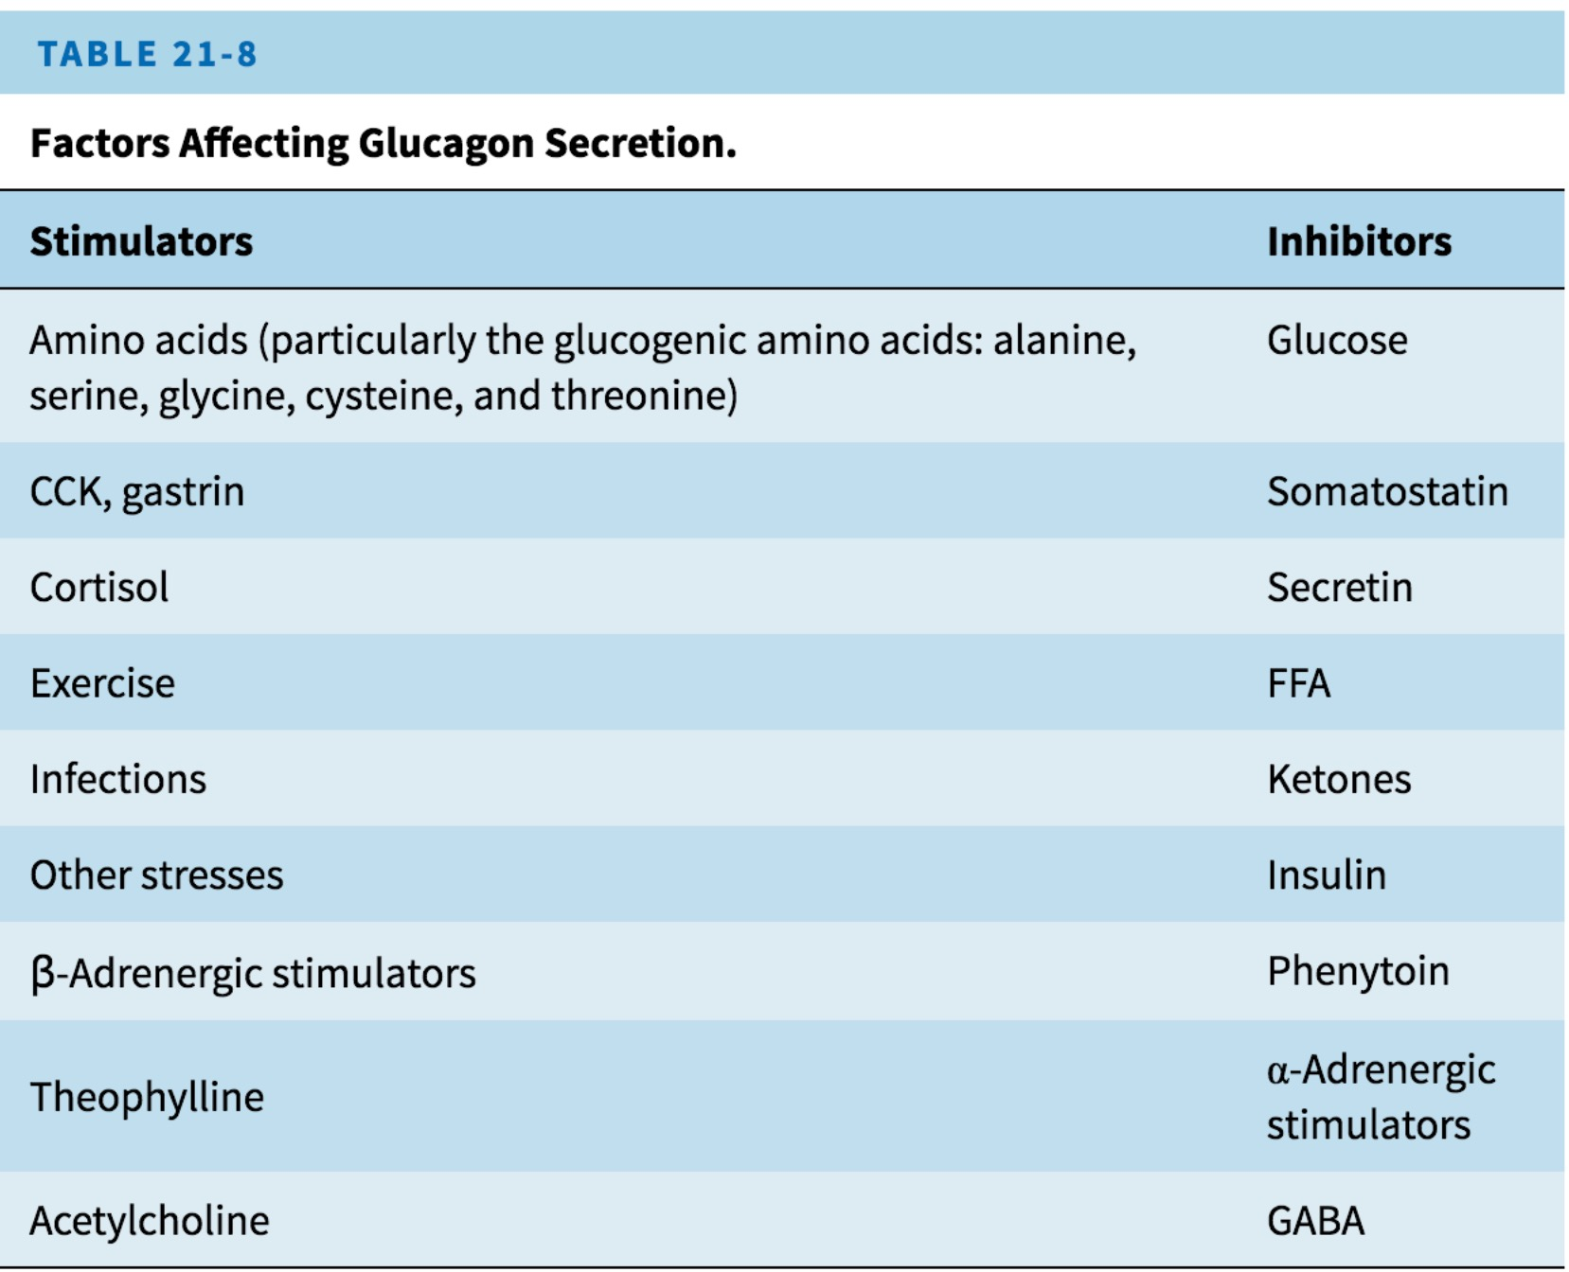
Notes:
Ganong

Slide 37
Describe the role of insulin in fat metabolism.
Notes:
36% of candidates passed this question. The following were the main points expected for a pass:
▪ description of insulin and its actions as an anabolic hormone, and consequences of activation of insulin receptors,
▪ the effects of insulin on liver: increased uptake glucose; production of glycerol and free fatty acids; and decreased ketogenesis,
▪ the effects of insulin on adipose tissue: glucose uptake; synthesis of fatty acids and glycerol and
▪ the activation of lipoprotein lipase and inhibition of hormone sensitive lipase.
Bonus marks were given for
▪ a structured approach to insulin’s action in fat metabolism,
▪ key enzymes involved in liver and adipose tissue,
▪ lipoprotein transport in blood and breakdown and uptake by adipose tissue.
Common mistakes included:
▪ only focusing on one of the following: fat uptake from gut, fat synthesis in liver or adipose tissue, or the role of increased glucose uptake;
▪ confusing anabolic and catabolic actions,
▪ providing information about actions of other hormones,
▪ providing information about diabetes and carbohydrate metabolism while neglecting to cover fat metabolism.
2009b(11)/2000b(7)/1998a(7): Describe the role of insulin in fat metabolism General: Insulin is a 51-amino acid hormone synthesised and stored in β cells of the Islets of Langerhans in the pancreas.
- It is an anabolic hormone
- Binds to insulin receptors on the cell membranes of tissues
o Internalised
o Direct interaction with tyrosine kinase receptor → ↑tyrosine kinase
activity → activate protein cascade which ↑transcription of genes
Effect on Fat Metabolism
1. ↑FatSynthesisinadiposetissue
- ↑Glucose uptake by adipose tissue
o ↑Glucose transporters (GLUT 4) insertion in cell membranes of adipose tissue → ↑facilitated diffusion of glucose
o Glucose is converted to fatty acids
▪ Glucose → pyruvate → Acetyl CoA → fatty acid
o Converted to glycerol for synthesis of triglycerides in cell ▪ ↑α-glycerophosphate formation
- ↑Lipid uptake by adipose tissue
o ↑LDL receptor activity of adipose tissue
o Activation of endothelial lipoprotein lipase → splits triglyceride
carried within LDL into FFA and glycerol → ↑absorption →
reconstituted within cell for storage 2. ↓Lipolysis
- Inhibition of hormone-sensitive lipase
o ↓triglyceride hydrolysis in adipose tissue → promotes storage
- ↓Ketone body formation in liver
3. ↑Triglyceridesynthesisinliver
- Excess glucose in liver (after glycogenesis is completed (100g)) glucose is
converted to fatty acids and stored in liver
o More important than adipose tissue formation
o ↑glucose uptake via ↑activity of glucokinase in hepatocytes (nil
glucose transporters required) → traps glucose within the cell 4. ↓Glucose-6-phosphataseactivityinliver
- Allows for increased glucose uptake by hepatocyte (this doesn’t require
the insertion of glucose transporters into the cell membrane)
- Decreased G-6-P activity maintains the glucose concentration gradient

Slide 38
Notes:
Ganong Table 21-4

Slide 39
Euglycaemic Ketoacidosis

Slide 40
Describe the physiological consequences of acute hypoglycaemia
Notes:
Disturbance of homeostasis
Sensor, integrator, effector
2006b(16): Describe the physiological consequences of acute hypoglycaemia
General: BSL is usually maintained within a narrow range (4-7mmol/L in adult)
- Maintained by negative feedback system:
o Detector = Islets of Langerhans’ cells, Stimulus: BSL, Effector:
Insulin:glucagon release/ratio
- Aim: ↑BSL to provide substrate for brain, RBC (obligate glucose
metabolisers)
Hypoglycaemia occurs when BSL < 3.0mmol/L Acute hypoglycaemia
- Nil compensatory mechanisms activated (hormonal changes have not occurred → min change glucagon, cortisol, GH)
- Early sign: Hunger
- Neurological impairment: confusion, agitation
o Progresses with ↓BSL → coma, seizure, death Physiological consequences of acute hypoglycaemia SNS activation:↑catecholamine release
- Effect:
o Central: Nausea, agitation, hunger
o Liver: ↑glycogenolysis, ↑glucose release
o Pancreas: Inhibit insulin release
o CVS: ↑HR, ↑SVR, peripheral shutdown, sweatiness
↓Insulin release: ↓BSL release detected by β cells of IoL - Effect:
o Adipose tissue: ↓glucose uptake (↓GLUT 4 transporters in membrane), ↓fat uptake (inhibition of lipoprotein lipase in endothelium), ↑FFA release (HSL)
o Muscle: ↓glucose uptake (↓GLUT 4), ↓protein synthesis, ↓glycogenesis, ↑FFA metabolism
o Liver: ↑glucose release (glycogenloysis), ↑FFA release, some KB formation, gluconeogenesis via glycerol (fats), and lactate (RBC metabolism)
Late Effect: ↓BSL will stimulate other hormonal changes which aim to ↑BSL over a sustained period
- ↑Glucagon → ↑hepatic gluconeogenesis from amino acids, lactate and glycerol
- Cortisol, GH → ↑FFA release from adipose tissue

Slide 41
List the main drug groups used in the treatment of DM. For each group explain the mechanism of action and give examples
Notes:
Diabetes mellitus is a common condition faced daily by anaesthetists. A thorough understanding of its management is a clinical necessity.
This is a two parts question requiring candidates to list the various groups of drug for the treatment of diabetes mellitus, and to describe their mechanisms of action. It is important that sufficient details, such as molecular and metabolic effects after drug administration, are included for the latter part of the question.
While most candidates were able to describe the classical oral hypoglycemic agents (i.e. sulphonylureas and biguanides) in detail, it was surprising that a substantial proportion of candidates did not consider insulin as a drug for the treatment of diabetes mellitus. Most answers were also vague regarding the different preparations of insulin that produce variation in the speed of onset and duration of action. Candidates who included the newer agents, such as thiazolidinediones, alpha glucosidase inhibitors and meglitinides, were rewarded with extra marks.
Exogenous Insulin: Recombinant E. coli produced. Used to be porcine / bovine
- Mechanism of Action: Replaces endogenous insulin → has same anabolic effects, binds to same tyrosine kinase-coupled receptors
- Route: s/c for regular dosing; IV for immediate action / titratability
- Preparations: short-acting (Actrapid), medium-acting and long-acting
preparations
o Dosing regime: basal-bolus (most physiological) / meal-adjusted
- Adverse reactions:
o Hypoglycaemia → if not corrected can lead to coma, death
o Lipodystrophy at s/c injection site 2° anabolic effect of insulin locally o Allergic reaction rare with recombinant preparations
Sulphonylureas (2nd generation: glibenclamide, gliclazide; nil 1st gen used) +
- Mechanism of Action: displace insulin from β cells in IoL by blocking K
channels → cell depolarisation → influx Ca2+ → release insulin o May have a minor role in ↓insulin insensitivity
o ↓plasma triglyceride, FFA, cholesterol
- Route: PO (oral bioavailability 100%)
- Distribution: 97% protein bound (1° albumin as weakly acidic), small Vd
o Competition for PB with warfarin
- Metabolism: Extensive hepatic metabolism to clinically inactive
compounds
- Elimination: Renal → drug action prolonged in renal failure
- Adverse reactions:
o GI upset,
o Severe hypoglycaemia: ↑risk with pre-op fasting, age>60, renal
failure, other drugs (salicylates, warfarin (less with 2nd gen))
o ↓efficacy with other drugs: sympathomimetics, thiazides, diuretics,
phenytoin, calcium channel blockers Biguanides (Metformin)
- Mechanism of Action:
o Enhance peripheral action of insulin, ↓insulin resistance, o ↓CHO absorption from GIT
o ↓gluconeogenesis (liver, kidney)
- Route: PO (oral bioavailability 60%)
- Distribution: Not protein bound
- Metabolism: Nil
- Elimination: Excreted in urine, ↑action of drug in renal impairment
- Adverse Reactions:
o NIL problems with hypoglycaemia
o Lactic acidosis → Metformin binds to mt membrane → ↓aerobic
glycolysis / ↑anaerobic glycolysis → pyruvate converted to lactate
in liver (Cori cycle)
o GI upset including diarrhoea
Thiazolidinediones (Rosiglitazone) By Amanda Diaz
Endocrine Drugs
- Mechanism of Action: Bind to intracellular (nucleus) receptors
peroxisome proliferator-activated receptors PPAR
o Effect: ↓insulin resistance, ↓leptin, anti-inflammatory action
- Adverse Reactions:
o Hepatitis
o Peripheral oedema o CCF
o ↑weight
Acarbose
- Mechanism of Action: ↓glucose uptake from the SI by preventing breakdown of long CHO chains
- Adverse Reactions: Not suitable as a sole agent (in combination with sulphonylureas/biguanides)
o Borborrigmy
o Diarrhoea / flatulence Alpha glucosidase Inhibitors
Meglitinides
By Amanda Diaz
Endocrine Drugs

Slide 42
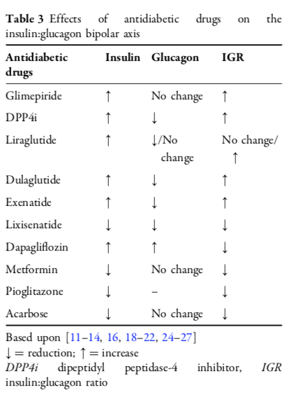

Slide 43
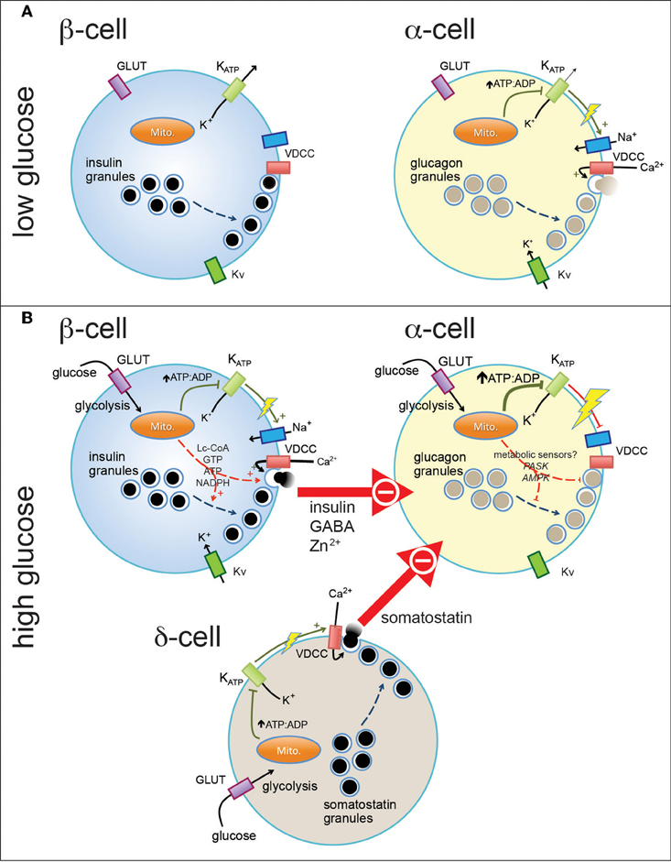

Slide 44
Describe the physiological effects of the glucocorticoids
Notes:
18% of candidates passed this question.
A large number of candidates answered this question as a pharmacology question, including irrelevant detail such as the indications and dosages for dexamethasone/steroid supplementation for surgery.
A similarly large number gave a description of Cushing's disease.
Points that were expected to be included: An opening statement including a definition, origin of and a statement that glucocorticoids are catabolic in nature
Candidates who organised their answ er into categories such as:
▪ Metabolism (and then broke this down to: Carbohydrate, Fat and Protein)
▪ Inflammation
▪ Effect on Foetus
▪ Other systems (Haematological, GI, Musculoskeletal etc)
demonstrated a global understanding and scored well
Candidates should note that neither Insulin nor lucagon are Glucocorticoids and that Glucose cannot be derived from Fatty Acids
Extra marks were given for describing the actions of glucocorticoids on an intranuclear receptor and mRNA transcription and the anti inflammatory effects

Slide 45
Briefly describe the secretion and functions of renin and angiotensin
Notes:
48% of candidates passed this question.
This question was asked in a slightly different form in July 2002 and attracted a similar pass rate at that time.
The main points that would gain a pass were:
▪ A description of the site of release of renin.
▪ The main stimuli that lead to the release of renin, including a reduction of systemic blood pressure and extracellular fluid, an increase in sympathetic stimulation and a decreased delivery of solutes to the *macula densa.
▪ The cleaving angiotensin I from angiotensinogen by renin.
▪ The conversion of angiotensin I to angiotensin II by the action of angiotensin converting enzyme, mainly by contact with pulmonary endothelium.
▪ A description of the main functions of angiotensin II, including vasoconstriction, alteration of glomerular filtration rate, direct action on the renal tubules and stimulation of aldosterone secretion.
▪ The ability of angiotensin II to inhibit the secretion of renin.
▪ This process leading ultimately to conservation of sodium and water.
Additional information that attracted further marks included:
▪ Detailed information about the process of renin secretion.
▪ Describing other stimuli for renin secretion over and above those described above.
▪ Explaining the site of synthesis of angiotensinogen.
▪ A description of the size, structure and half-lives of renin and the various subtypes of angiotensin.
▪ Other functions of angiotensin II, over and above those described above.
▪ The relative potency of angiotensin III.
▪ More detailed descriptions of the intimate processes and interactions of the system.
Common mistakes or omissions included:
▪ Confusion over the exact cells that secrete renin.
▪ Inexact descriptions or omissions of the interrelationship of renin to angiotensin.
▪ Confusion over the way solute load reaching the macula densa affects renin secretion.
▪ Incorrect associations with the process of tubuloglomerular feedback.
▪ Very detailed and often correct descriptions of the actions of aldosterone and vasopressin, at the expense of the required information.

Slide 46
Paper 1 Q21
Erythropoietin:
(a) is a circulating hormone without which hypoxia has little or no effect on red cell production
(b) is formed in the kidney and in the liver
(c) production is stimulated by epinephrine and norepinephrine
(d) production is increased within minutes of the development of hypoxia
(e) activity is decreased when the red cell volume is increased
Notes:
true (b) true (c) true (d) false (e) true
Erythropoietin is a haemopoietic glycoprotein growth factor derived from a single gene on chromosome seven, which is expressed in cells of the renal cortex. Some 10% is produced by the liver by unknown cells; this amount is not enough for normal functioning. Its key action is to control erythropoiesis. Normally erythropoietin is produced as a result of hypoxia detected by an oxygen sensor; it then acts back on an effector receptor. There is normally a rise in levels in anaemia.
Erythropoietin secretion is stimulated by:
hypoxia
cobalt salts
androgens
alkalosis
catecholamines
adenosine
Erythropoietin secretion is inhibited by:
increased red cell volume
theophylline

Slide 47
Feb-April 2017
Outline the physiological effects of the adrenal hormones aldosterone and cortisol. (Do NOT describe synthesis or metabolism).
Notes:
14. Outline the physiological effects of the adrenal hormones aldosterone and cortisol. (Do NOT describe synthesis or metabolism).
65.5% of candidates achieved a pass in this question
Marks were gained for a brief description of the mechanism of action of these steroid hormones, specifically that they act intracellularly on DNA transcription altering protein synthesis.
An outline of the effects of aldosterone required determining where in nephron it works, upon which cells, and which channels and pumps are involved in these actions. It was not enough to only state that aldosterone causes reabsorption of Na (and H2O by osmosis) and secretion of K. The effect upon H secretion was also expected. Better responses illustrated the numerous triggers for aldosterone release beyond just mentioning the renin-angiotensin system, and showed understanding of the triggers for renin release.
The effects of cortisol are widespread and candidates were NOT expected to cover them all to attain a pass mark, though better answers were rewarded for their breadth of understanding. The plethora of marks available was weighted towards the more important effects, and it was expected that metabolic actions (carbohydrate, protein, fat) and immune system effects would be well outlined. For example, many candidates correctly stated that cortisol stimulates catabolism. Better answers, however, would briefly elaborate to show that this provides amino acids which are then available for gluconeogenesis, and may also lead to muscle wasting...gaining several more marks in the process. Comments on catecholamine responsiveness, fetal lung maturation, CNS effects were also rewarded, as was an illustration of the hypothalamic/pituitary axis, triggers for cortisol release and feedback mechanisms.
Common errors included confusing aldosterone with ADH, and misunderstanding the terms catabolic and anabolic. Numerous candidates spent time discussing the adrenal anatomy, or the adrenal medullary hormones, and marks were not given for this.

Slide 48
Aug/Sept 2016
Explain the physiological processes that cause oliguria in response to hypovolaemic shock.
Notes:
3. Explain the physiological processes that cause oliguria in response to hypovolaemic shock.
33.5 % of candidates achieved a pass in this question
The question required candidates to provide definitions of oliguria and hypovolaemic shock followed by a succinct but detailed description of how hypovoalemia activated the sympathetic nervous system, with subsequent activation of the renin/angiotensin/aldosterone system (RAAS) and antidiuretic hormone (vasopressin) release, either from sympathetic stimulation, RAAS or changes in osmolarity.
Ranges for oliguria varied from 0.5 mLs/Kg/Hr to 30 mLs/Kg/Hr. Most answers correctly defined shock as inadequate tissue perfusion, but some candidates still defined shock in terms of an absolute blood pressure.
The commonest reason for a low scoring answer was purely inadequate detail. Most respondents were able to give a broad overview of the basic mechanisms but failed to elaborate. Simple statements such as ‘activation of RAAS’ or equations related to filtration coefficient and capillary pressures without explanations how they effected oliguria, in the setting of hypovolaemic shock, were insufficient to gain marks.
Frequent mistakes included mentioning RAAS but then neglecting one or more of its components, suggesting renin converted angiotensin I to angiotensin II, only mentioning 1 or 2 actions of angiotensin II, and neglecting the actions of ADH at V1 receptors to mediate vasoconstriction.
As in previous years, the range of renal autoregulation parameters, when given, was frequently incorrect. A minority of candidates gave the correct value (50-150 mmHg).

Slide 49
Feb/Apr 2016
Describe the physiological role of prostaglandins on smooth muscle throughout the body
Notes:
Describe the physiological role of prostaglandins on smooth muscle throughout the body.
35% of candidates achieved a pass in this question
In this question, candidates were expected to define prostaglandins and to highlight the diversity of different derivatives produced. There are a number of smooth muscle groups that are of interest in this question. These include the vascular smooth muscle, pulmonary vasculature, bronchi, gastrointestinal tract and those in the genitourinary systems, especially the uterus and the urinary bladder. It should be noted that different prostaglandins may produce opposing effects. For instance, PGI2 is a vasodilator, but TxA2 contracts vascular smooth muscle. Similarly, the same prostaglandin may produce different effects in different tissues (e.g. PGI2 contracts sphincters in the gastrointestinal tract, but relaxes the vascular smooth muscle). Therefore, candidates should be specific in their answers by stating the prostaglandin and the muscle group involved.
Many candidates included irrelevant details, such as nociceptive effect, inflammatory function and gastric acid secretion as part of their answer. It was also noted that a substantial number of candidates did not attempt the question or wrote very minimally on the question, and may represent a problem of time management.

Slide 50
Aug/Sept 2014
How is renal blood flow regulated? What are the physiological effects of angiotensin II?
Notes:
How is renal blood flow regulated? What are the physiological effects of angiotensin II?
57% of candidates achieved a pass in this question
Better answers were written with a reasonable structure that included:
• A definition of renal blood flow, with normal values
• Flow = renal perfusion pressure / renal vascular resistance.
• The anatomy of renal blood supply (only a brief description was necessary) and
recognition that the vascular tone of the afferent and efferent arterioles is the main
determinant of renal vascular resistance.
• Describing autoregulation between a range of mean arterial pressures (A wide range of
values was accepted here).
• An explanation of myogenic autoregulation. This was often overlooked or not
discussed in much detail.
• Notes about tubuloglomerular feedback, including the structure and function of the
juxtaglomerular complex, and the activation of the renin-angiotensin-aldosterone
cascade.
• The role of the sympathetic nervous system.
Additional points were awarded for extra detail about release and effects of local and circulating hormones (such as ANP/noradrenaline/adrenaline/adenosine/NO/prostaglandins) on afferent and efferent arteriole tone.
Common errors included: confusing glomerular filtration rate and renal blood flow, vague and imprecise statements about effects of different hormones, omitting detail and listing bullet points without explanation.
Effects of angiotensin II:
A list of these was sufficient for a pass mark – in particular the cardiovascular, CNS, renal and autonomic effects. Further marks were awarded for an increased level of detail. For example, most candidates were able to write that angiotensin II was a potent vasoconstrictor. More marks were awarded if this was followed with a description that angiotensin acted on peripheral arteries and veins, leading to an increase in SVR and MAP.
The renal effects were reasonably well described, but few candidates explained that angiotensin II has a greater effect on the efferent arteriole than the afferent arteriole. Credit was given if candidates could explain that the net effect of an increased level of angiotensin II is to increase water/salt retention and increase the effective circulating volume.

Slide 51
Sept/Nov 2013
Describe the physiological effects of endogenous glucocorticoids.
Notes:
Describe the physiological effects of endogenous glucocorticoids.
38.9% of candidates achieved a pass in this question
Good answers were well organized with a concise introductory heading followed by classification into metabolic, immunological, haematological, musculoskeletal, gastrointestinal, foetal, vascular and permissive effects.
Some good answers included a description of mechanism of action of cortisol at the molecular level, which gained extra marks. Similarly, candidates who were able to explain why cortisol is a “stress hormone” and what benefits it confer to the individual scored extra marks. A few well- written answers also included a discussion of how cortisol exerts its anti-inflammatory effects.
Many candidates mentioned osteoporosis as a physiologic effect when in fact it occurs only in conditions of excess glucocorticoids over long periods.
Irrelevant to the question are:
- Circadian nature of ACTH secretion, which is the cause of confusion to many candidates. (Cortisol is NOT the hormone responsible for normal sleep-awake cycle)
- Regulatory control of cortisol and the negative feedback loop. (However, marks were awarded to candidates who mentioned that glucocorticoids inhibit ACTH secretion)
- A system-based description of Cushing syndrome, which is a pathological state.
- Steroid supplementation during surgery.
The main cause for failing this question was insufficient detail demonstrating a lack of knowledge and poor understanding.

Slide 52
Feb/Apr 2013
What are the major classes of oral hypoglycaemic agents? Outline their mechanisms of action and possible side effects.
Notes:
What are the major classes of oral hypoglycaemic agents? Outline their mechanisms of action and possible side effects.
11% of candidates achieved a pass in this question
The main focus for this question was on the mechanism of action and side effects of biguanide and sulphonylurea drugs. However, marks were also given for mentioning newer oral hypoglycaemic agents. Marks were not awarded for insulin or glucagon-like polypeptide-1 receptor agonists which are given subcutaneously. Knowledge of the receptor mechanism for sulphonylureas and enzyme activation for biguanides was expected. Misconceptions occurred regarding the action of sulphonylureas: they do not ‘displace’ insulin from β cells. Also, biguanides do more than just ‘increase tissue sensitivity’. Marks were awarded for clinically important side effects and for naming factors (many of which occur perioperatively) that increase the risk of side effects. Extra marks were awarded for: an understanding of whether or not a functioning pancreas is required for drug action, lipid effects of oral hypoglycaemic drugs and for an understanding of the major differences in the side effects between biguanides and sulphonylureas and why these occur.

Slide 53
Paper 1 Q24
Aldosterone:
(a) does not directly affect renal blood flow
(b) increases the acidity of urine
(c) reduces the sodium content of sweat
(d) potentiates the effects of vasopressin in hypovolaemia
(e) is excreted in response to angiotensi
Notes:
true (b) true (c) true (d) false (e) true
Aldosterone is a 21-carbon steroid derived from the precursor cholesterol. It is the main endogenous mineralocorticoid hormone. It is produced from corticosterone by the zona glomerulosa of the adrenal cortex mainly in response to angiotensin II.
Aldosterone probably causes activation of a specific Naþ/Kþ active pump in the distal renal tubule. This leads to reabsorption of sodium and water from the urine in exchange for potassium and hydrogen ions. Sodium retention causes a secondary retention of water.
Aldosterone causes a reduction in the sodium and an increase in the potassium concentration of both sweat and saliva. This effect is not seen in cystic fibrosis.
Regulation of aldosterone release is by:
angiotensin II via the renin–angiotensin system
potassium, via a direct action on the zona glomerulosa
low levels of serum potassium appear to have an inhibitory effect on aldosterone secretion
high levels of serum potassium increase aldosterone secretion
ACTH has a minimal effect except at very high concentrations when it stimulates secretion
hyponatraemia increases aldosterone secretion via a direct effect on the zona glomerulosa
Aldosterone may be competitively inhibited by drugs such as spironolactone.

Slide 54
Paper 2 Q2
Parathyroid hormone:
(a) is a mucopolysaccharide
(b) inhibits osteolytic action
(c) activates vitamin D
(d) increases urinary excretion of phosphate
(e) is released in response to a low extracellular concentration of free calcium
Notes:
(a) false (b) false (c) true (d) true (e) true Parathyroid hormone (PTH) is secreted by the parathyroid glands as a polypeptide containing 84 amino acids. The main physiological actions of parathyroid hormone are: (a) Mobilisation of calcium from bone by stimulating osteoclasts to reabsorb bone mineral, liberating calcium into blood. (b) Enhancing absorption of calcium from the small intestine indirectly by stimulating production of the active form of vitamin D
in the kidney. Vitamin D induces the synthesis of a calcium-binding protein in intestinal epithelial cells that facilitates efficient absorption of calcium into blood. (c) Suppression of calcium loss in urine. This effect is mediated by stimulating tubular reabsorption of calcium. Another effect of PTH on the kidney is to stimulate loss of phosphate ions in urine.

Slide 55
Paper 2 Q29
Secretion of corticotrophin:
(a) controls glucocorticoid production
(b) controls catecholamine production
(c) is increased by the secretion of a hypothalamic releasing factor
(d) is suppressed by a high level of circulating glucocorticoids
(e) has a circadian variation
Notes:
What is “corticotrophin”? Corticotropin?
(a) true (b) false (c) true (d) true (e) true
ACTH is principally responsible for regulating secretions of the adrenal cortex, especially cortisol. It also stimulates the formation of cholesterol in the adrenal cortex. Secretion of ACTH responds most dramatically to stress and is under the control of corticotropin-releasing hormone from the hypothalamus. Secretory rates of corticotropin-releasing hormone and ACTH are high in the morning and low in the evening

Slide 56
Paper 3 Q22
Vasopressin secretion is increased by:
(a) decreased pressure in the right ventricle
(b) increased pressure in the aorta
(c) decreased pressure in the right atrium
(d) increased pressure in the right ventricle
(e) increased pressure in the right atrium
Notes:
(a) false (b) false (c) true (d) false (e) false
Vasopressin is a hormone synthesised in the hypothalamus and transported along axons bound to neurophysin carrier proteins. Antidiuretic hormone is also called ADH, vasopressin or arginine vasopressin (AVP). It descends the pituitary stalk to the posterior pituitary gland. It is secreted by the posterior pituitary gland in response to:
hypovolaemia
high plasma osmolality
decreased tension in the great veins
emotional stress
raised temperature at the hypothalamus
pain
various drugs, e.g. carbamazepine, clofibrate, morphine
Normal plasma vasopressin or ADH is approximately 4 pg/ml.
There are several mechanisms regulating the release of AVP. Hypovolaemia, as occurs during haemorrhage, results in a decrease in atrial pressure. Specialised stretch receptors within the atrial walls and large veins (cardiopulmonary baroreceptors) entering the atria decrease their firing rate when there is a fall in atrial pressure. Afferent nerve fibres from these receptors synapse within the nucleus tractus solitarius of the medulla, which sends fibres to the hypothalamus, a region of the brain that controls AVP release by the pituitary. Atrial receptor firing normally inhibits the release of AVP by the posterior pituitary. In hypovolaemia or decreased central venous pressure, the decreased firing of atrial stretch receptors leads to an increase in AVP release. Hypothalamic osmoreceptors sense extracellular osmolarity and stimulate AVP release when osmolarity rises, as occurs with dehydration. Angiotensin II receptors located in the hypothalamus regulate AVP release. An increase in angiotensin II simulates AVP release. ADH acts at two types of receptors. V1 (for vasopressin receptor 1) is found in vascular smooth muscle while V2, which works by adenylate cyclase activation, is found in the kidney. ADH binding to V2 receptors in the kidney increases cyclic adenosine monophosphate (cAMP) levels, which in turn increase the water permeability of the renal tubule. The increased resorption of water by the renal tubule decreases urine volume and increases urine osmolality. ADH binding to the V2 receptor in the smooth muscle in the gastrointestinal tract causes peristalsis (contractile waves). ADH agonists, such as desmopressin and DDAVP, increase blood pressure. Desmopressin is an analogue of ADH that is more potent and longer acting. It has little vasoconstrictor activity. DDAVP is the commercial name for desmopressin acetate. ADH agonists are indicated for use only during abdominal surgery. Drugs that act on the sympathetic nervous system to increase peripheral resistance without decreasing coronary blood flow are better choices for the treatment of low blood pressure.

Slide 57
Paper 4 Q12
Antidiuretic hormone (ADH):
(a) acts on the peritubular capillary side of the collecting duct
(b) is synthesised in the paraventricular nucleus of the
hypothalamus as a precursor molecule
(c) has a plasma half-life of about 2 min
(d) travels to the anterior pituitary via the hypothalamic-hypophyseal tract
(e) acts on vasopressin VIb receptors to release ACTH
Notes:
true (b) false (c) false (d) false (e) true
Antidiuretic hormone (ADH) is a nonapeptide synthesised in the supraoptic nucleus of the hypothalamus. It is transported via the hypothalamic–hypophyseal nerve tract to the posterior pituitary. It is released from the posterior pituitary to the circulation by the nerve cells. It has a half-life of 18 min.
Types of vasopressin receptors
V1a receptors: located in the blood vessels; causing vasoconstriction when stimulated
V1b receptors: located in the anterior hypothalamus, causing increased ACTH secretion when stimulated
V2 receptors: located in the kidneys (peritubular capillary side of the collecting duct), causing antidiuresis when stimulated. These are G-protein-coupled receptors.

Slide 58
Paper 4 Q20
Corticotrophin
(a) has a diurnal variation
(b) is under the control of hypothalamic releasing factor
(c) regulates glucocorticoid secretion
(d) regulates catecholamine release
(e) release is decreased with prolonged steroid therapy
Notes:
(a) true (b) false (c) true (d) false (e) true
Corticotrophin is the releasing factor secreted by the hypothalamus that stimulates adrenocorticotrophin hormone (ACTH) secretion from the anterior pituitary. It is released in response to physical or emotional stress. Like many body functions there is a diurnal variation. ACTH controls the production and release of corticosteroids, glucocorticoids and aldosterone from the adrenal gland. Glucocorticoids have a negative feedback on ACTH production. Long-term steroid therapy has the potential for long- term suppression of ACTH but this is probably rarer than thought in the past.

Slide 59
Paper 5 Q28
Parathyroid hormone secretion increases in response to:
(a) a decrease in extracellular calcium concentration
(b) an increase in extracellular magnesium concentration
(c) an increase in vitamin D
(d) propranolol
(e) prednisolone
Notes:
true (b) false (c) false (d) false (e) true
Parathyroid hormone (PTH):
Increases movement of Ca2 and HPO4 out of bone
Increases renal tubular reabsorption of Ca2
Reduces renal tubular reabsorption of HPO4
Stimulates production of vitamin D (indirect effect)
Inhibits proximal tubular H+ secretion and HCO3 reabsorption
The decrease in plasma pH displaces Ca2+ from plasma protein and bone
Increased HPO4 excretion aids further reabsorption from bone due to an effect on the [HPO4 ]·[Ca2+] solubility product
Hyperparathyroidism causes:
an elevated plasma calcium with a low to normal phosphate
enhanced bone reabsorption with cyst formation
ectopic calcification
renal stones – renal Ca2þ excretion increases, despite the elevated PTH, as the filtered mass increase is much greater than the reabsorptive increase

Slide 60
Paper 5 Q29
The following will increase the secretion of thyroxine (T4)
a decrease in circulating tri-iodothyronine (T3)
increased secretion of calcitonin
somatostatin
a cold environment
an increase in iodide absorbed from the gastrointestinal tract
Notes:
(a) true (b) false (c) false (d) true (e) false
Thyroid-stimulating hormone secreted from the anterior pituitary controls thyroxine secretion and the conversion of T4 to T3 in the peripheral tissues. There is a direct inhibitory feedback loop. Each day, 80 mg to 103 nmol of T4 and 4 mg (7 nmol) of T3 is secreted.
Somatostatin inhibits growth hormone and the production of insulin and glucagons. As a neural transmitter it may be part of the nociceptive pathway.

Slide 61
Paper 5 Q30
Aldosterone
(a) is released from the posterior pituitary
(b) is released from the adrenal cortex
(c) decreases renal sodium secretion
(d) increases potassium secretion
(e) is excreted in response to angiotensin
Notes:
(a) false (b) true (c) true (d) true (e) true
Aldosterone is released for the adrenal cortex, stimulated by angiotensin II, increased plasma potassium and adrenocorticotrophin or ACTH. It acts on the renal collecting ducts to stimulate sodium reabsorption and potassium and hydrogen excretion. Aldosterone is responsible for the reabsorption of sodium in the kidney, intestine, sweat and salivary glands.

Slide 62
Paper 6 Q3
The following are synthesised in the hypothalamus
(a) prolactin
(b) growth hormone
(c) vasopressin
(d) thyroid-stimulating hormone
(e) corticotrophin-releasing hormone
Notes:
false (b) false (c) true (d) false (e) true
The hypothalamus directly controls the posterior pituitary. It controls the anterior pituitary through releasing or inhibitory factors.
The hypothalamus synthesises and secretes ADH and oxytocin, which it releases through the posterior pituitary gland. Acetylcholine increases release and noradrenaline inhibits release.
The anterior pituitary granular secretory cells are either acidophils, producing prolactin and somatotropin, or basophils, producing the trophic glycoproteins ACTH, TSH, LH and FSH and beta-lipotrophin (LPH). The anterior pituitary neurones are postganglionic sympathetic nerves.
From the basophils:
TSH (thyrotrophin) is a glycoprotein acting on the thyroid gland
ACTH (adrenocorticotrophin) is a 39-amino-acid polypeptide acting on the adrenal cortex
Growth hormone is a 191-amino-acid polypeptide controlled by somatotrophin releasing factor
From the acidophils
Prolactin is a polypeptide promoting milk production

Slide 63
Paper 6 Q4
With regard to calcium absorption
(a) it is passive
(b) it is increased by parathyroid hormone
(c) calcium is so effectively absorbed that there is hardly any calcium in the stool
(d) it is increased by calcitonin
(e) it is reduced by the fat-soluble vitamin D
Notes:
(a) false (b) true (c) false (d) false (e) false
Absorption is from the proximal small intestine involving an active carrier mechanism promoted by vitamin D and parathyroid hormone. Vitamin D acts on bone, kidneys and the small intestine to raise plasma calcium levels.
Parathyroid hormone acts to raise plasma calcium levels by bone resorption and to reduce renal tubular loss of calcium in the distal tubules and collecting ducts. Calcitonin reduces plasma calcium by increasing renal excretion, inhibiting bone reabsorption and inhibiting jejunal reabsorption.
Deficiencies of vitamin D and cholecalciferol will lead to poor calcium absorption.
The fat-soluble vitamins are A, D, E and K.

