Slide 1
Cellular Physiology
ANZCA Primary Examination Tutorial
Dr Rhys Thomas
Notes:
Introduction:
Names
My background
Apologies in advance. Normally like to make totes interactive, asking questions, drawing on white boards etc. Not sure how well this will transition into a Zoom tute…but will try and keep it interactive, and please do stop me an ask any questions along the way, and I will try and keep an eye on the comments section, so feel free to ask questions there.
Will try and stop after each section as well…

Slide 2
Primary Exam Resources
My blog site:
http://drgetafix.com/2018/08/18/anzca-primary-exam-tutorials-resources/
(Contains slides, articles, video links and other suggestions)
Notes:
But, I do have a copy of both slides and audio from my previous tutes on this topic on my blog site, which you may already be aware of, so if this tute falls in a heap, it could be worth check out some of my previous ones.
Also includes slides and audio recording of the other tutes I give, as well other resources and suggestions.
I will add this link into the comments of this Zoom meeting….

Slide 3
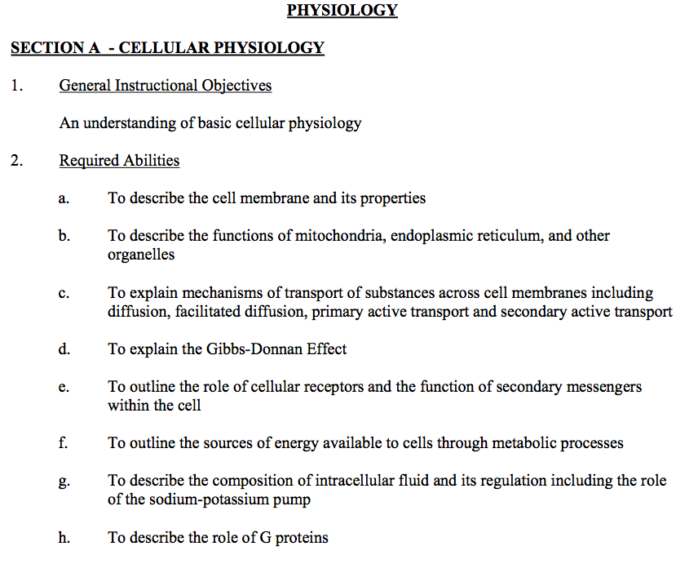
Notes:
Phys/Pharm
Recommended textbook
Rang, Dale and Ritter
Disclaimer
New syllabus
More nebulous
If it’s in recommended text books, it’s examinable
Feedback

Slide 4
Notes:
Spherical Cow: A farmer employs some scientists and engineers to work out the most efficient way to milk his cows. They eventually come back with their solution, something along the lines of:
“Lets a consider a perfectly elastic spherical cow in a vacuum…”
A lot of these explanations are grossly oversimplified but they teach the important concepts and provide a grounding to then explore further, and most importantly, these spherical cows are enough to get you through the primary exam!

Slide 5
Cell Membrane
Notes:
What can you tell me about the cell membrane?
Structure
Phospholipid bilayer-what is a phospholipid? (Next slide)
Glycolipid
Sterols
Proteins
Integral-“Integrated” into the membrane”. Large hydrophobic section, and hard to isolate from the membrane
Peripheral-comparatively loosely attached to the membrane, and isolated from it more easily
Glycosylated, lipidated etc
GPI anchored
Glycosylphosphatidylinosito;
“Fluid Mosaic Model”
icebergs; implications for signal transduction later
What changes fluidity?
Saturated vs unsaturated
Sterols
Specialised areas (motor endplate, gap junctions, desmosomes)

Slide 6
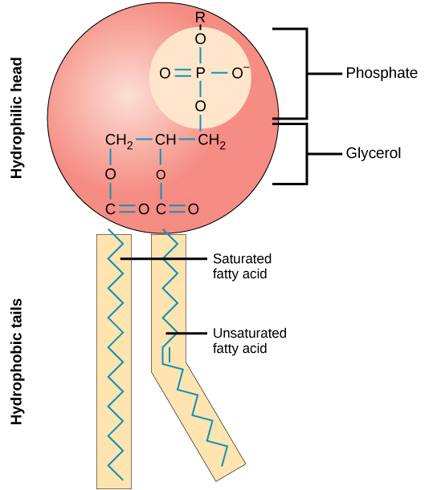
https://opentextbc.ca/biology/chapter/3-4-the-cell-membrane/

Slide 7
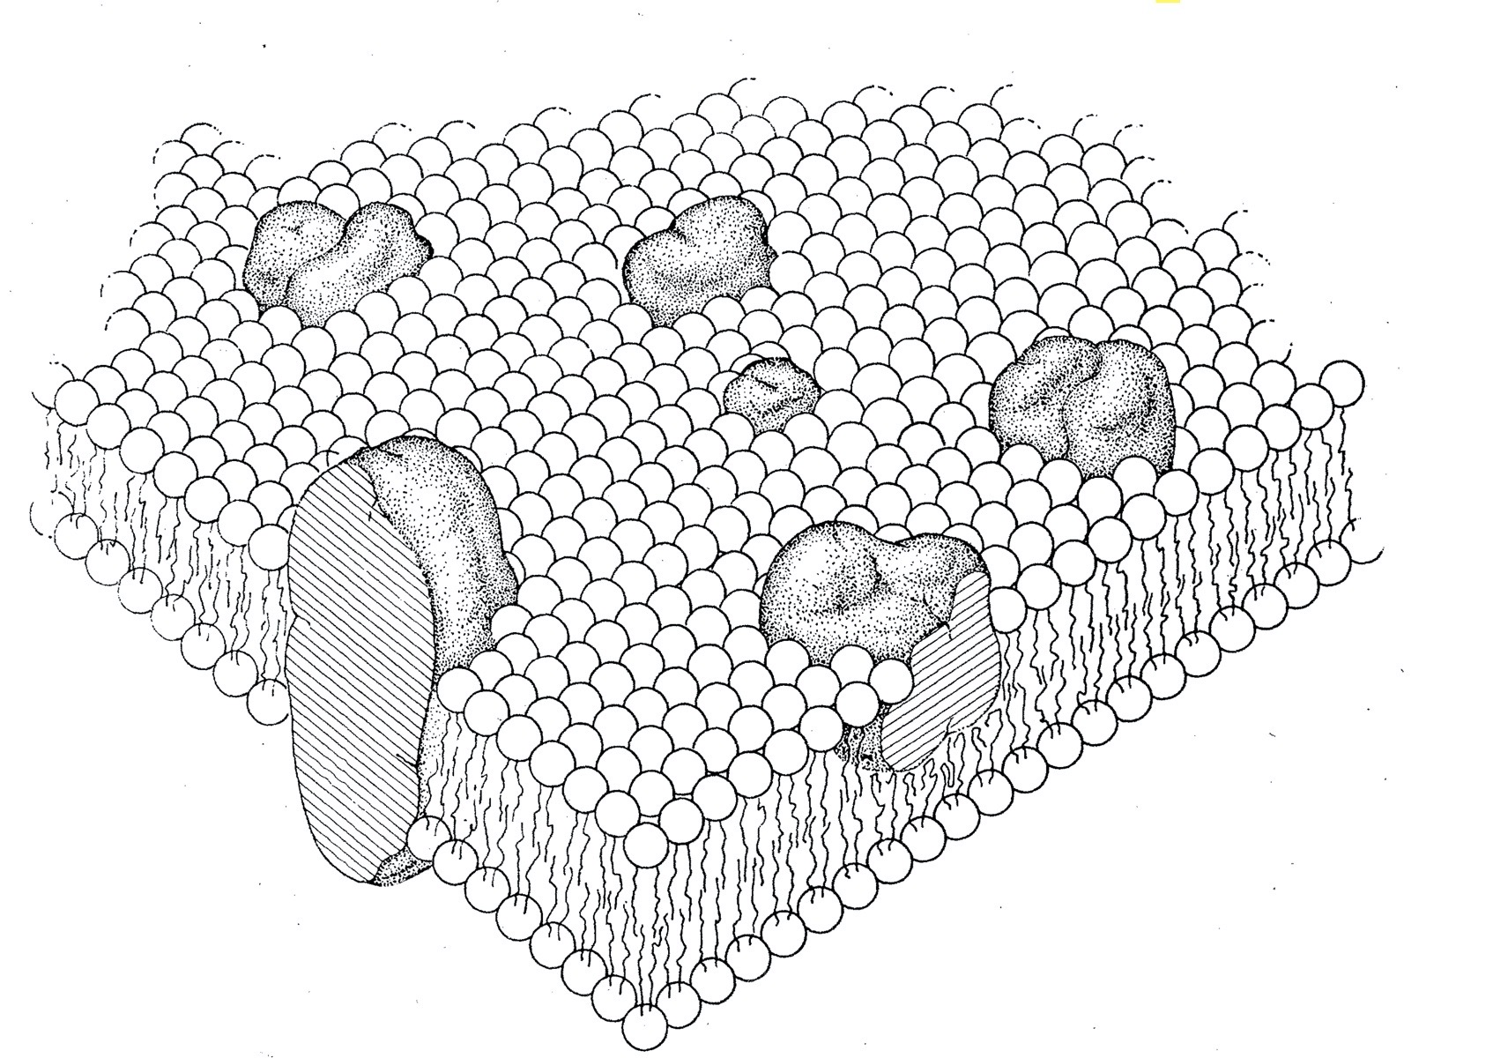
The Fluid Mosaic Model of the Structure of Cell Membranes Singer & Nicolson, 1972.
https://www.jstor.org/stable/1733071
Notes:
Image from the original paper describing the model.
Structure
Phospholipid bilayer-what is a phospolipid?
Sterols
Proteins
Integral-“Integrated” into the membrane”. Large hydrophobic section, and hard to isolate from the membrane
Peripheral-comparatively loosely attached to the membrane, and isolated from it more easily
Glycosylated, lipidated etc
GPI anchored
Glycosylphosphatidylinosito;
“Fluid Mosaic Model”
Dynamic, not static; things are moving
icebergs; implications for signal transduction later
What changes fluidity?
Saturated vs unsaturated
Sterols
Specialised areas (motor endplate, gap junctions, desmosomes)

Slide 8
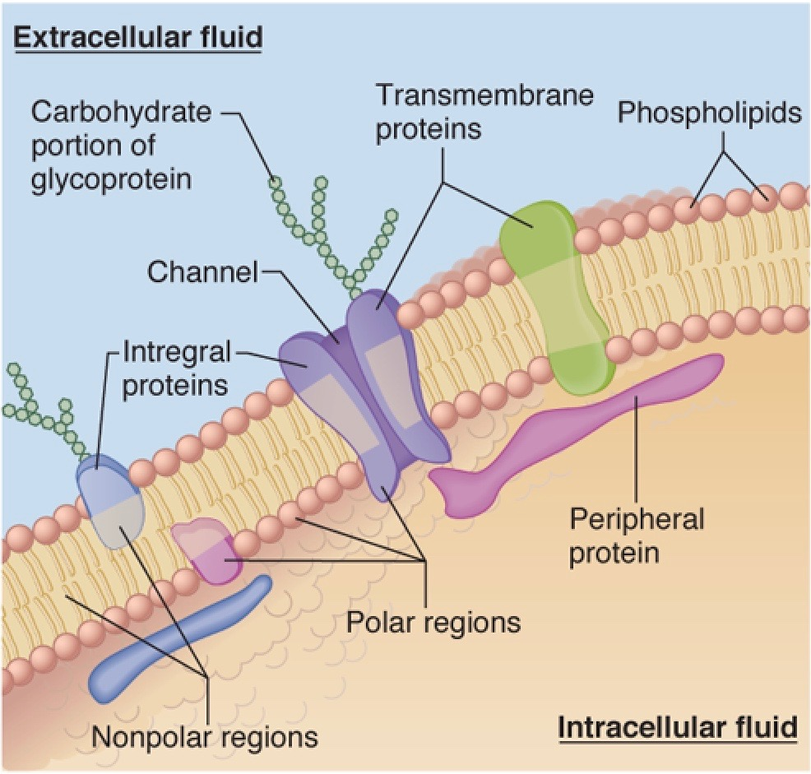
Notes:
Shows it in a bit more detail
Integral vs peripheral
Polar vs non-polar; hyrophillic vs hydrophobic

Slide 9
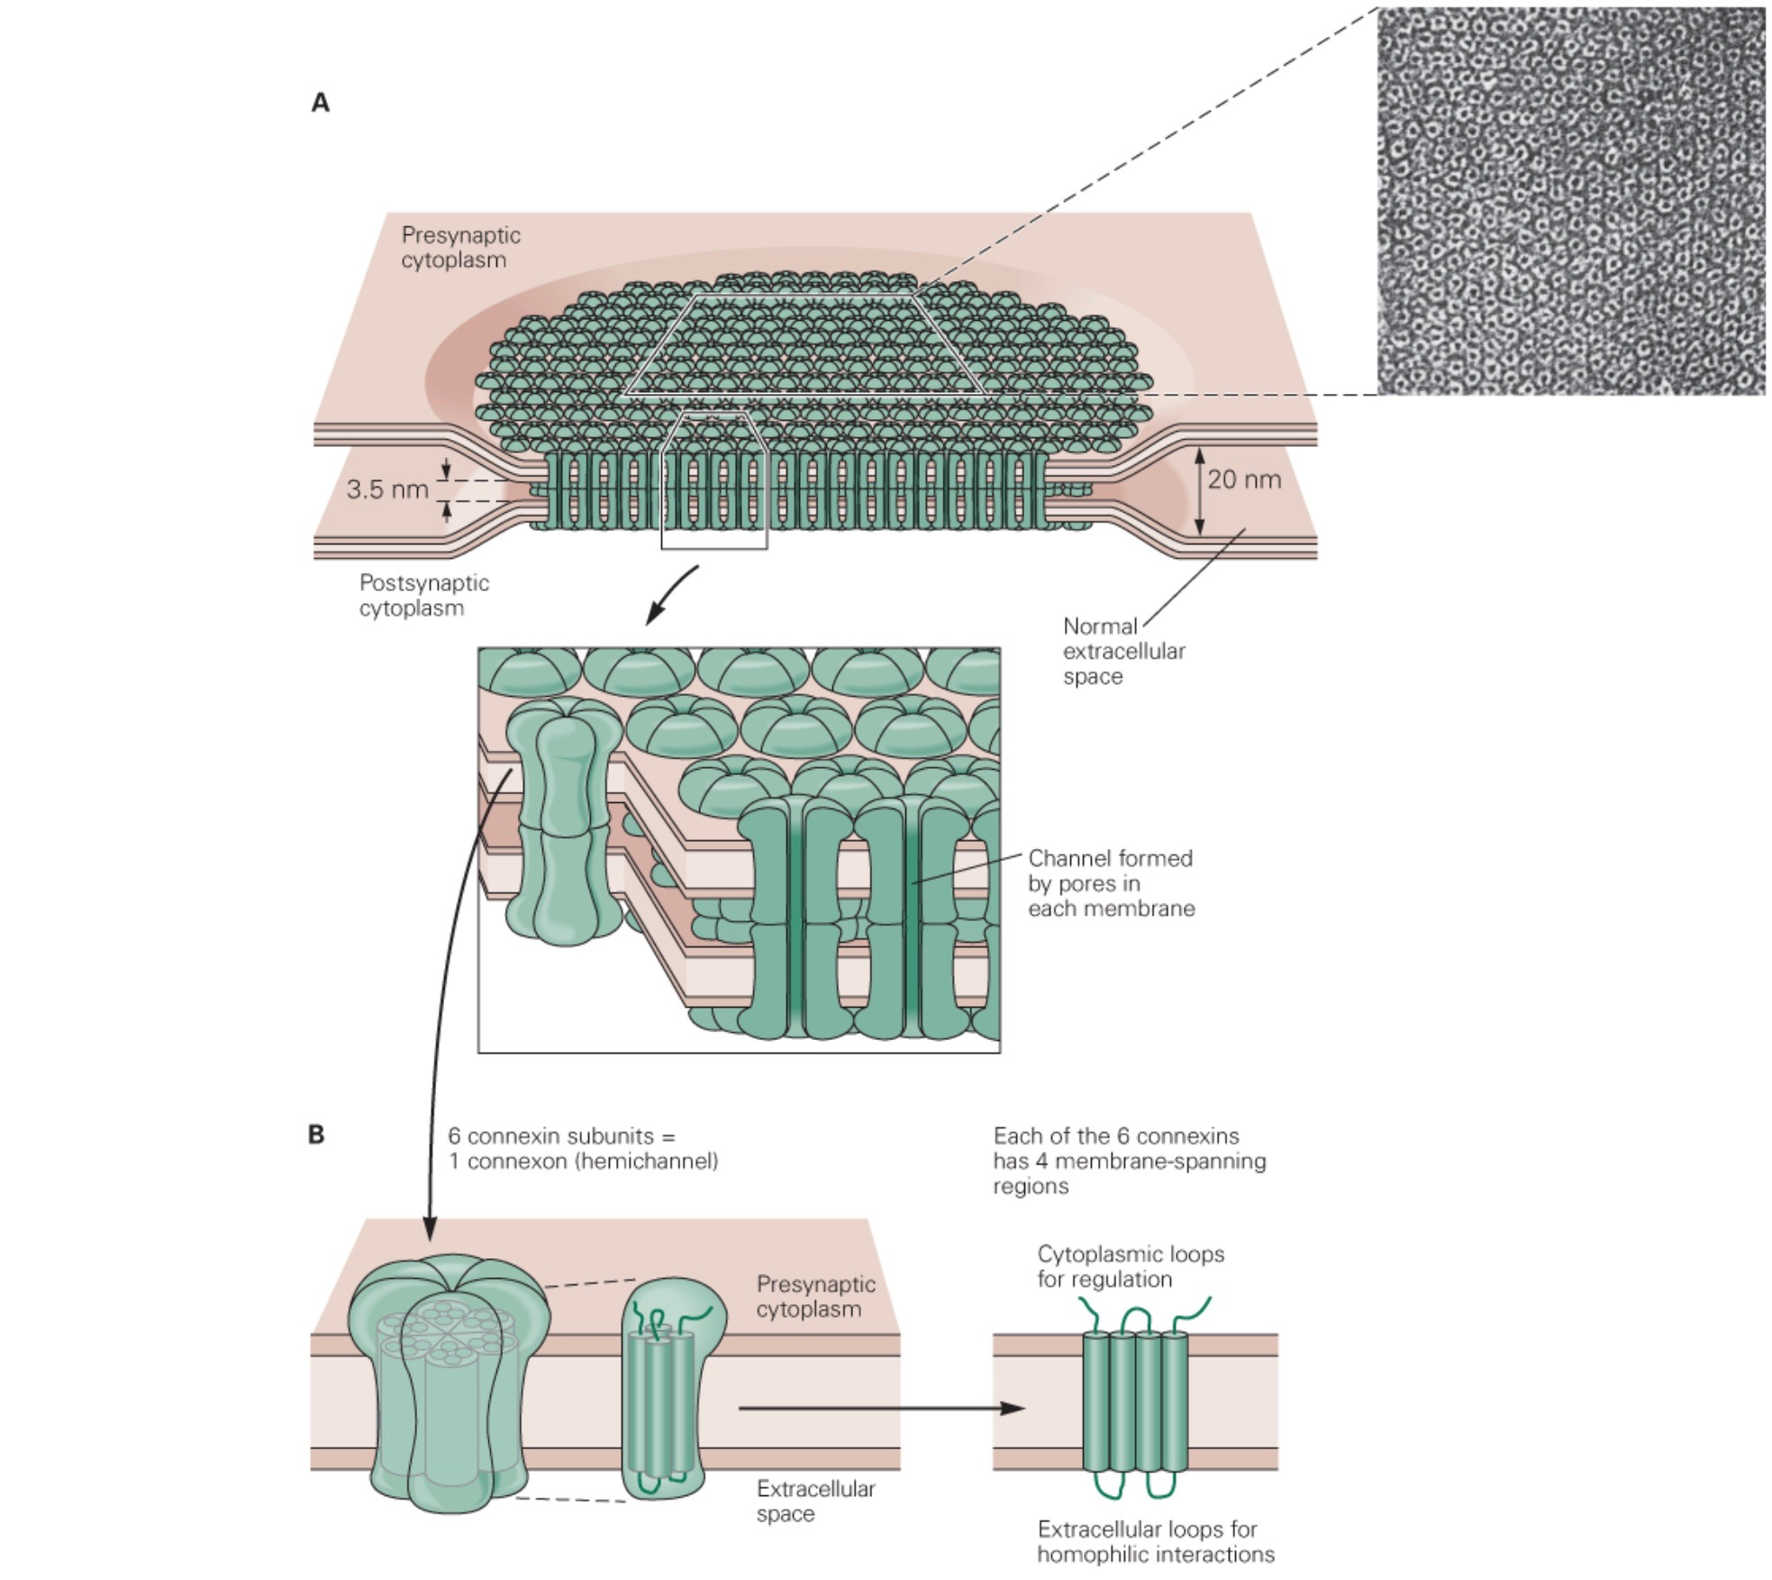
Notes:
Specialised areas of cell membrane…can anyone tell me what these are?
Gap Junctions
Where are these important?
Cardiac and smooth muscle

Slide 10
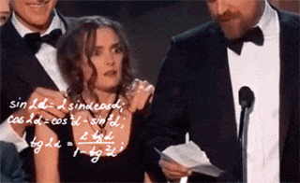
How do anaesthetics work?
Notes:
This might seem a little off topic, but I’m interested to know what the current teaching is on how general anaesthetics, both inhaled and IV work?
Had any tutes on this? Anyone done any reading? What kind of theories have you heard?
Meyer-Overton Hypothesis?

Slide 11
Notes:
Ted Eger videos on YouTube, linked from my blog.

Slide 12
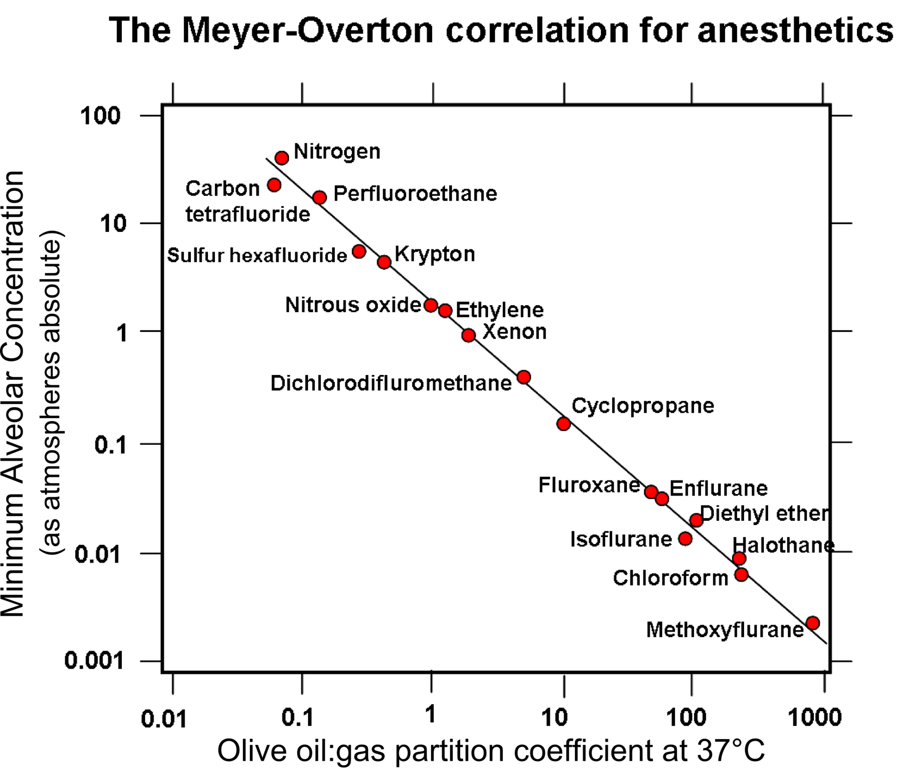
Meyer-Overton Hypothesis
Notes:
Correlation between hydrophobicity and potency…the more soluble in oil, the more potent.
What does this suggest about the site of action?
Been a lot of debate and back and forth over the years…

Slide 13
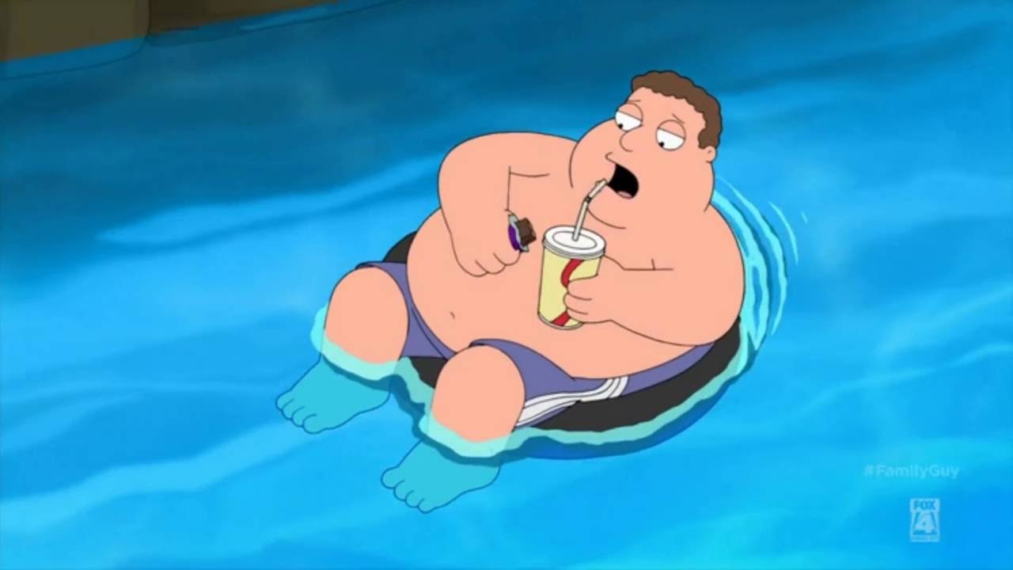
Lipid Rafts
Notes:
Anyone heard the term “lipid rafts”?
Recently a bit of discussion about it in the context of general anaesthesia…on Twitter at least!

Slide 14
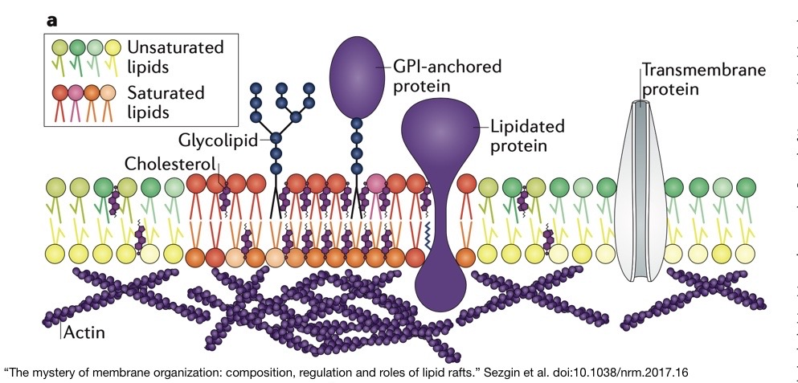
Notes:
“Lipid Rafts”-essentially an evolution of the fluid mosaic model. They found “lateral heterogeneity” in the fluid mosaic. The distribution of proteins and lipids etc wasn’t random Brownian motion or diffusion etc.
Due to the different physical and chemical properties of the many different types of lipids, plus the fact that they are free to move in this sea of lipids, the idea is that they will organise themselves into the most thermodynamically favourable arrangement.
Saturated phospholipids, cholesterol, lipidated proteins etc come together and form “lipid rafts”, in a sea of unsaturated phospholipids and other proteins
The recent buzz around them related to some experiments that seemed to elucidate the mechanism, or at least *a* mechanism, by which anaesthetic agents cause unconsciousness. Well, in fruit flies at least!

Slide 15
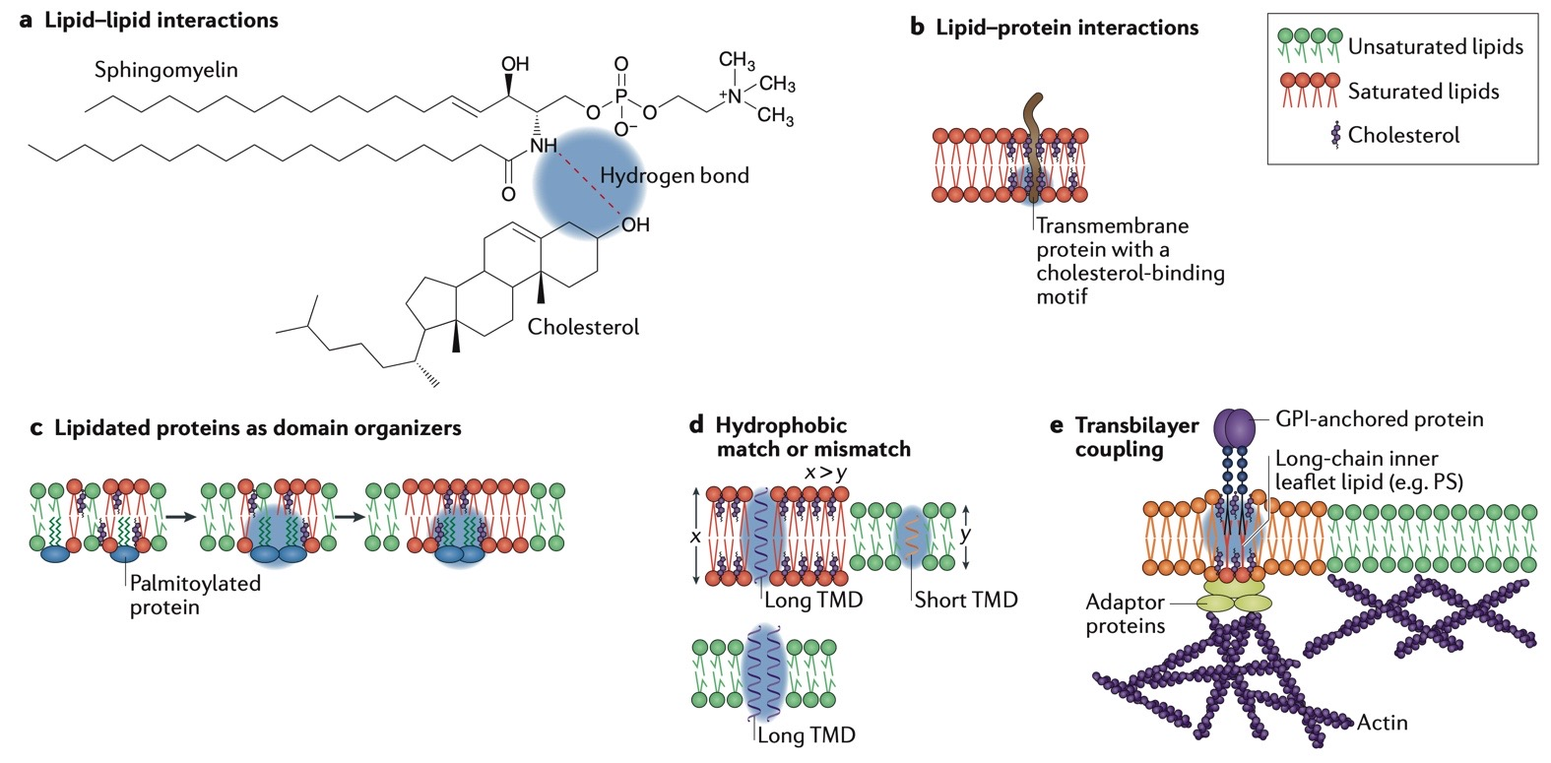
The mystery of membrane organization: composition, regulation
and roles of lipid rafts. Sezgin et al. DOI: 10.1038/nrm.2017.16

Slide 16
Studies on the mechanism of general anesthesia. Pavel et al. DOI: 10.1073/pnas.2004259117
Notes:
The blue dots (“ordered”) are the very hydrophobic saturated phospholipids, cholesterol, lipidated proteins etc that form lipid “ordered” lipid bilayer. aka “raft”.
Grey dots are the less hyrdrophobic phospholipids and proteins that for a “disordered” lipid bilayer
Orange hexagons a molecules of anaesthetic agent.
The idea is that the highly lipid soluble anaesthetic agents are incorporated into these lipid rafts, and cause them to expand, and fall apart a bit. Pretty sure “disurption” is not a real word! Disruption.

Slide 17
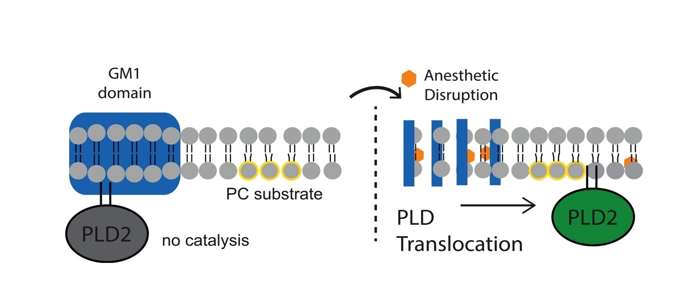
Studies on the mechanism of general anesthesia. Pavel et al. DOI: 10.1073/pnas.2004259117
Notes:
Normal state.
Phospholipase D2 is hanging out in a lipid raft (aka GM1 domain)
It’s substrate is a phospholipid called phosphatidylcholine (PC), but it can’t access them because it’s in the “disordered” part of the membrane with other less hydrophobic lipids.
When the raft is disrupted (or disurpted!) by the anaesthetic agent, the PLD2 moves into the disorder part of the membrane and can now convert PC into phosphatidic acid
(PA)

Slide 18
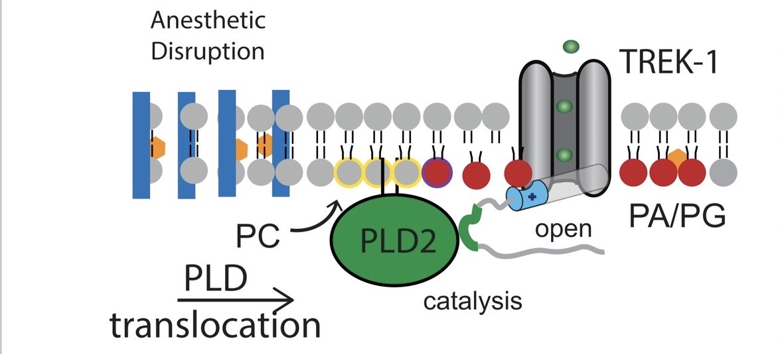
Studies on the mechanism of general anesthesia. Pavel et al. DOI: 10.1073/pnas.2004259117
Notes:
Anaesthetic disruption of lipid rafts, translocation of PLD2 out of the raft to site where it can act on phosphatidylcholine (PC) and is also collected with these “TREK-1” channel, and produce phosphatidic acid, which are the red dots here. It then binds to and opens the TREK-1 channel
TREK-1 is a type of potassium channel, which kind of segues nicely into the next topic…

Slide 19
Resting Membrane Potential
Notes:
What do we mean by the term?
How is it generated? (Big spherical cow!)
Resting membrane potential
Semi-permeable membrane
Concentration gradient generated/maintained by Na+/K+/ATPase
Ions move down their concentration gradient
Greater permeability to K+ means more K+ moves out than Na+ moves in, and in doing so causes a net negative charge along the inside of the plasma membrane
Emphasise “dynamic equilibrium” (ions still move)
Nernst & Goldman equations (simulator)
Equilibrium potential for different ions (reversal potential)
Most discussion is about effect of K+, Na+ (& Ca2+ in cardiac action potential), but what about Cl-
Mention GABA & Glycine briefly
Mention electrogenic Na+/K+/ATPase & Gibbs-Donnan effect & their small contribution to RMP
Gibbs-Donnan also in cell volume, oncotic pressure
Small contribution to RMP
More osmotically active particles in cells are outside due to charged proteins
Cells would rupture if not for Na/K+ pump
Donnan effect across capillary wall because more proteins in plasma than intersitium

Slide 20
Resting Membrane Potential
Semi-permeable membrane
Concentration gradient generated by Na+/K+ ATPase
Ions move down their concentration gradient?
Notes:
What do we mean by semi-permeable?
What are the different permeabilities?
Na+ very low in resting state
Small but significant permeability in resting state.
What can you tell me about the ATPase?
What directions is it pumping ions?
How many of each?
3Na- out, 2K+ in
Implications?
What stops the ions moving down the concentration gradient?
Electrical gradient
Final state of the cell “at rest”
Negative inside compared to outside.
Only along the very edge of the plasma membrane. The ECF and cytosol are broadly electroneutral

Slide 21
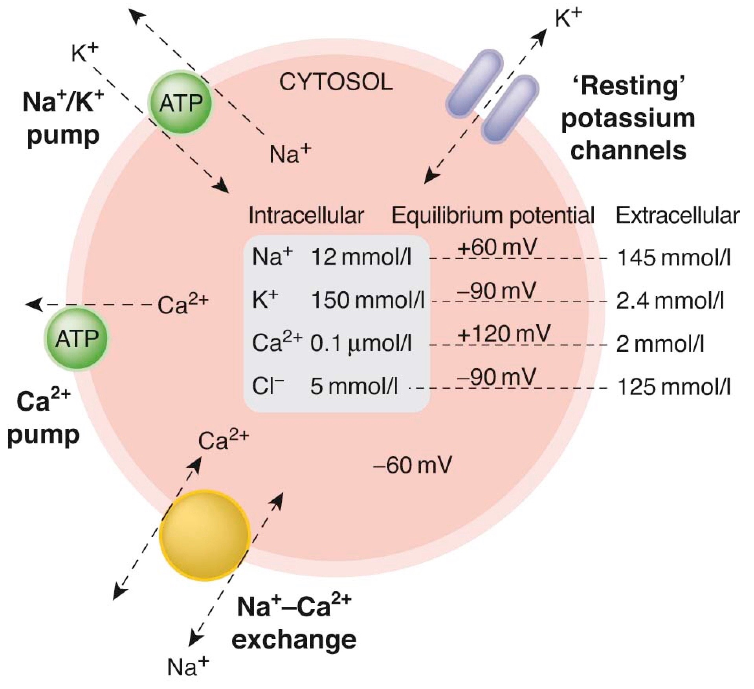
Rang & Dale. 8th Edition
Notes:
Exact values will depend in the cell, and the textbook. This is from Rang and Dale.
While it is possible to measure these values, you can also determine them mathematically…anyone know how?

Slide 22
Goldman Equation
Notes:
What can you tell me about this?
F= Faraday’s constant. I think Blair Munford referred to it in the electrical safety tute a few weeks back?
Do you notice a difference between Na, K & Cl?
Why?
Chloride is a negatively charged ion, while

Slide 23
Rang & Dale. 8th Edition
Notes:
So what will happen if you change any if these concentrations? Or the permeabilities?
“Equilibrium Potential”
Will find a new “resting” state. “Dynamic equilibrium”
What role does Chloride play? What would happen if you increased Cl- permeability?
Can you think of when we might do that?

Slide 24
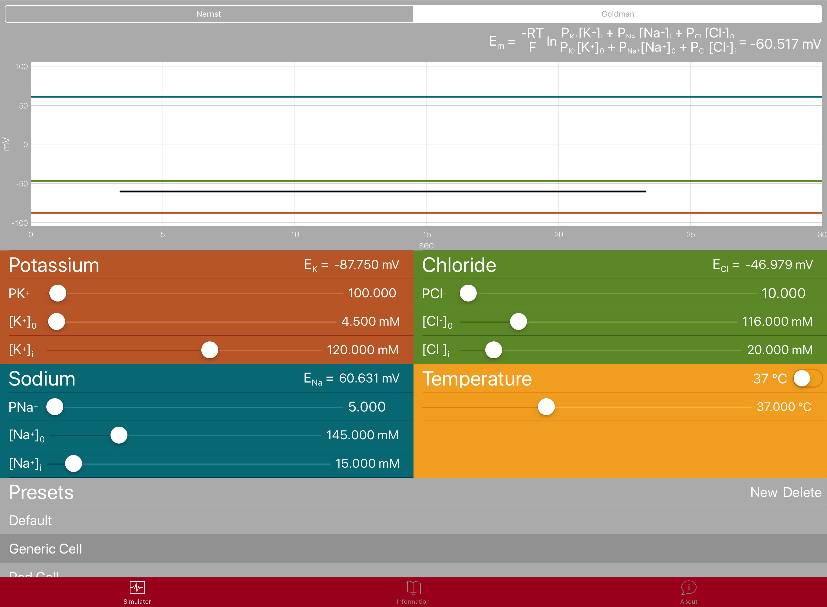
Goldman simulator

Slide 25
Gibbs-Donnan Equilibrium
Notes:
Where is this important?
Cell volume
RMP
Plasma oncotic pressure

Slide 26
Studies on the mechanism of general anesthesia. Pavel et al. DOI: 10.1073/pnas.2004259117
Notes:
So back to lipid rafts and TREK-1.
TREK-1 is a potassium channel…so, given what we’ve just looked at, how might this mechanism produce anaesthesia?
What happens when you open a potassium channel? Efflux of potassium..hyperpolarisation.

Slide 27
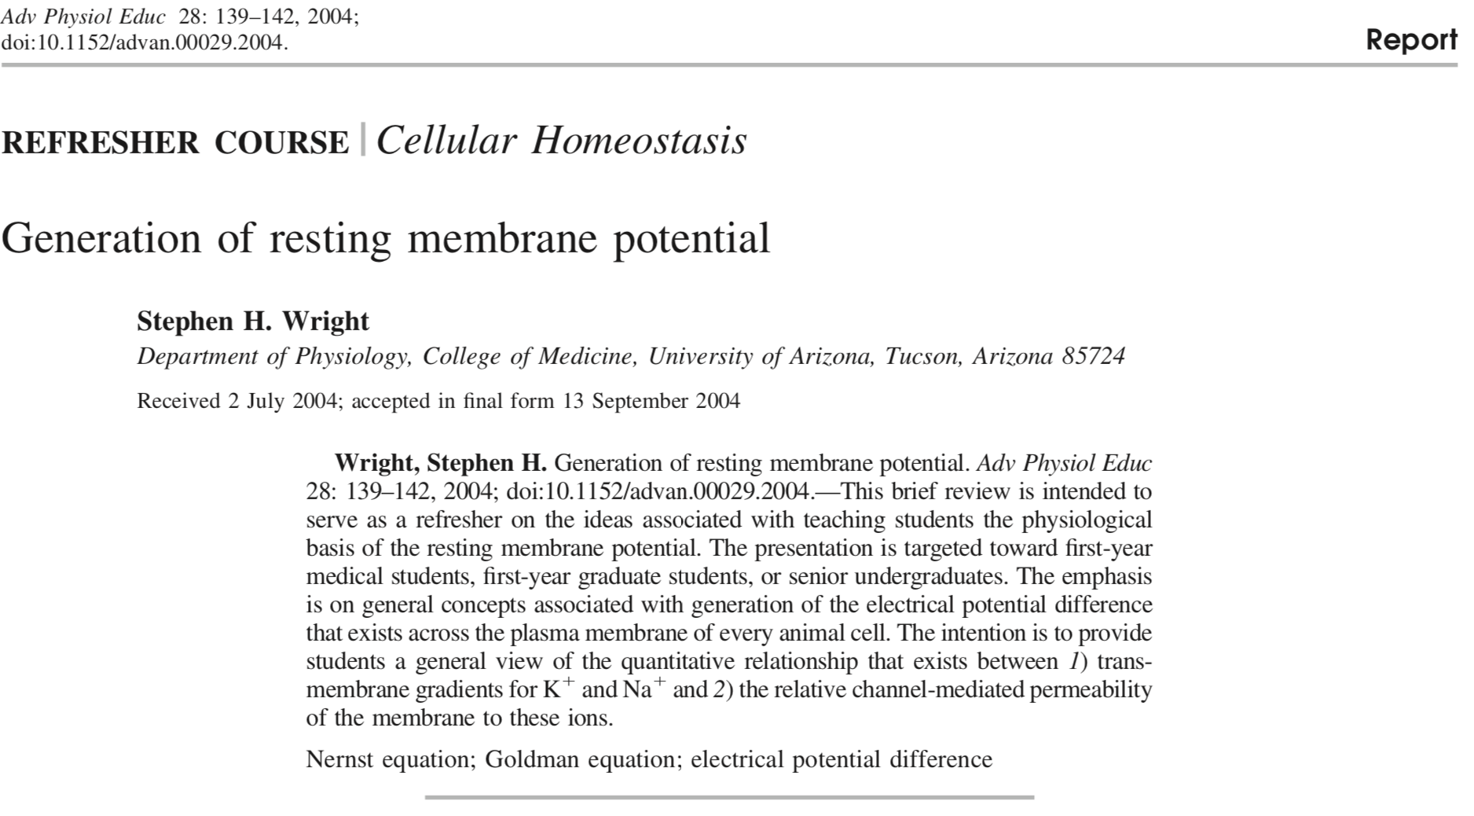
Notes:
This paper does a good job of describing the mechanism, and there’s a link to it on my blog.

Slide 28
How do we get things across the membrane?
Notes:
Ask for examples and write headings
Diffusion (O2, CO2)
Fick
Facilitated diffusion
Na, K, Glucose
Primary active transport
Na/K/ATPase
Proton pump
Secondary active transport
Use of sodium gradient (SGLT)
Exocytosis/Endocytosis (not really “across” membranes)
(Nascent proteins)
Signals
Ligand gated ion channels
GPCR
Tyrosine kinase linked
Nuclear receptors

Slide 29
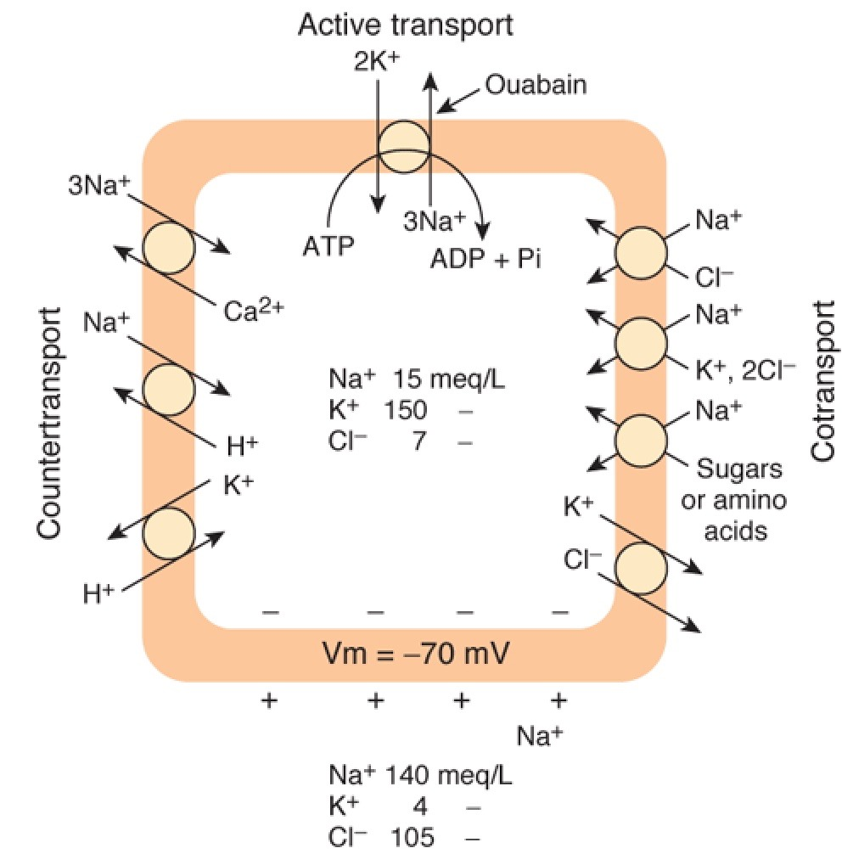
Gangong. 23rd edition
Notes:
Ask for examples and write headings
Diffusion (O2, CO2)
Fick
Facilitated diffusion
Na, K, Glucose
Primary active transport
Na/K/ATPase
Proton pump
Secondary active transport
Use of sodium gradient (SGLT)
Exocytosis/Endocytosis (not really “across” membranes)
(Nascent proteins)
Signals
Ligand gated ion channels
GPCR
Tyrosine kinase linked
Nuclear receptors

Slide 30
Transport Across the Membrane
Diffusion
O2, CO2
Facilitated diffusion
Na, K, Glucose
Primary active transport
Na/K/ATPase
Proton pump
Secondary active transport
Use of sodium gradient (SGLT)
Exocytosis/Endocytosis (sort of!)

Slide 31
What about signals?
Notes:
Ask for examples
Signals
Ligand gated ion channels
GPCR
Variations?
Thrombin: cleaves N-terminus of GPCR which then auto-activates. Irreversible unlike ligand binding
Tyrosine kinase linked
Nuclear receptors
Will cover these in more depth in later tutes
For now, take a closer look at GPCR…what can you tell me about them?

Slide 32
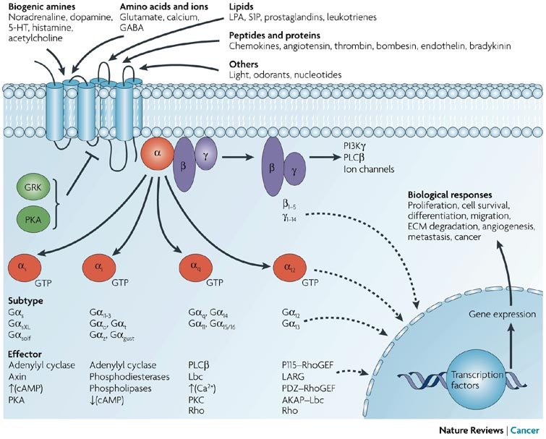

Slide 33
Organelles
Notes:
Organelles
Nucleolus
Nucleus
Endoplasmic Reticulum
Smooth
Rough
Ribosome
Golgi apparatus
Mitochondrion
Centriole
Vacuole
Lipid granules
Secretory granules
Cytoskeleton

Slide 34
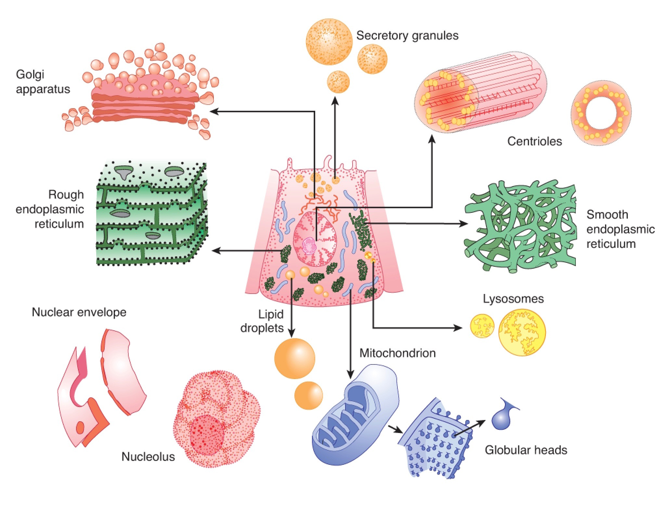
Gangong. 23rd edition

Slide 35
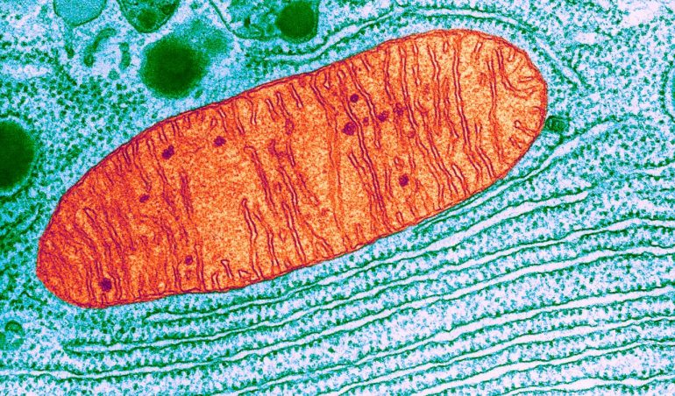
https://www.nature.com/articles/d41586-019-00792-9
Notes:
Ask them to describe its features and structure etc
Mitochondrion
Structure
Outer membrane
Intermembrane space
Inner membrane
Cristae
Matrix
Mitochondrial DNA (inheritance; diseases)

Slide 36
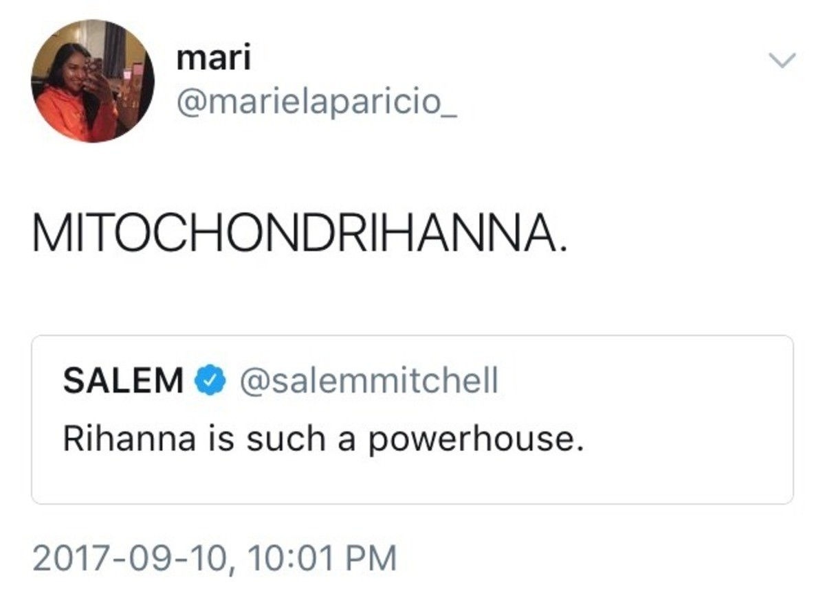
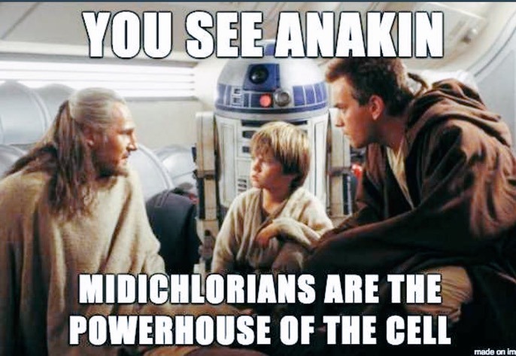
Notes:
Draw Electron Transport Chain and describe oxidative phosphorylation before going onto next slides.

Slide 37
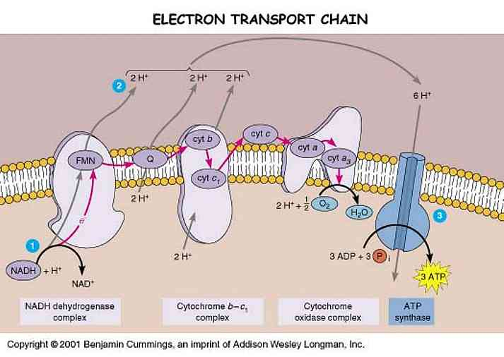
Notes:
Function
Oxidative phosphorylation
Brown fat
Thermogenin; “coupling”
Cyanide; Di-Nitrophenol
Pyruvate & citric acid cycle (Krebs, TCA)
(Beta-oxidation
Why do we make lactate when anaerobic

Slide 38
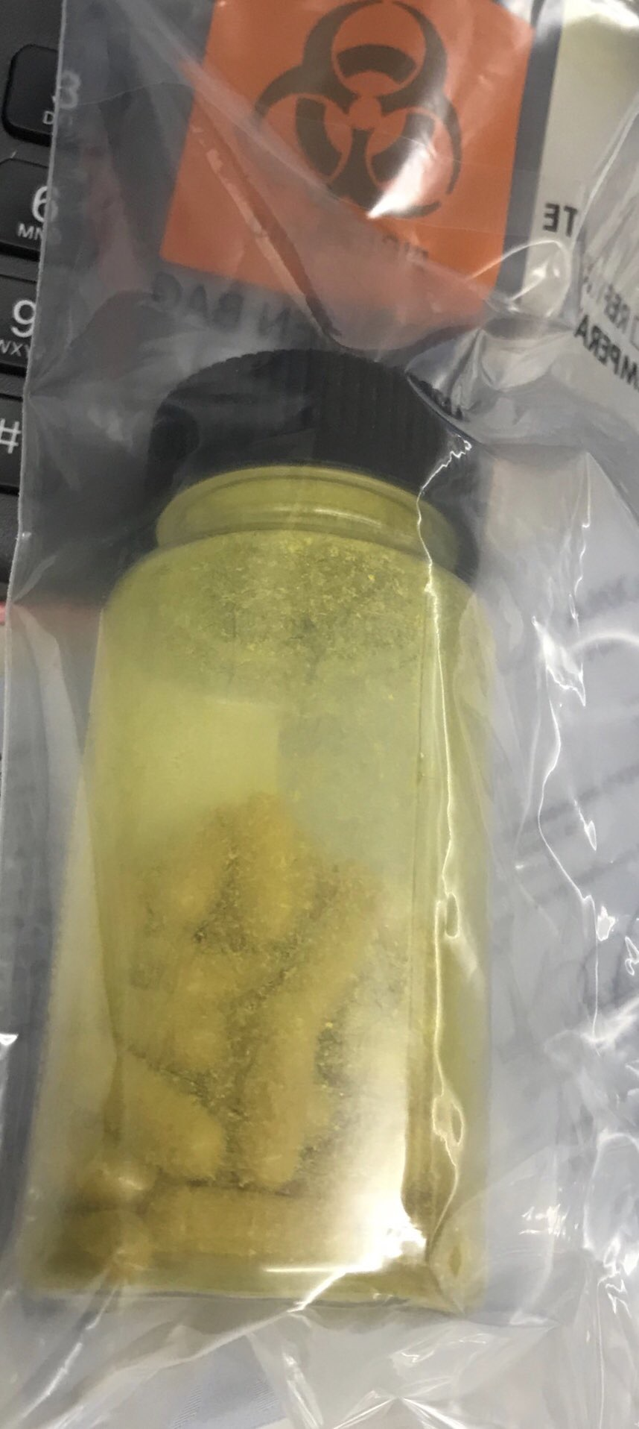
https://twitter.com/swissmiss83/status/1008293349965647872
Notes:
Function
Oxidative phosphorylation
Brown fat
Thermogenin; “coupling”
Cyanide; Di-Nitrophenol
Pyruvate & citric acid cycle (Krebs, TCA)
(Beta-oxidation
Why do we make lactate when anaerobic

Slide 39
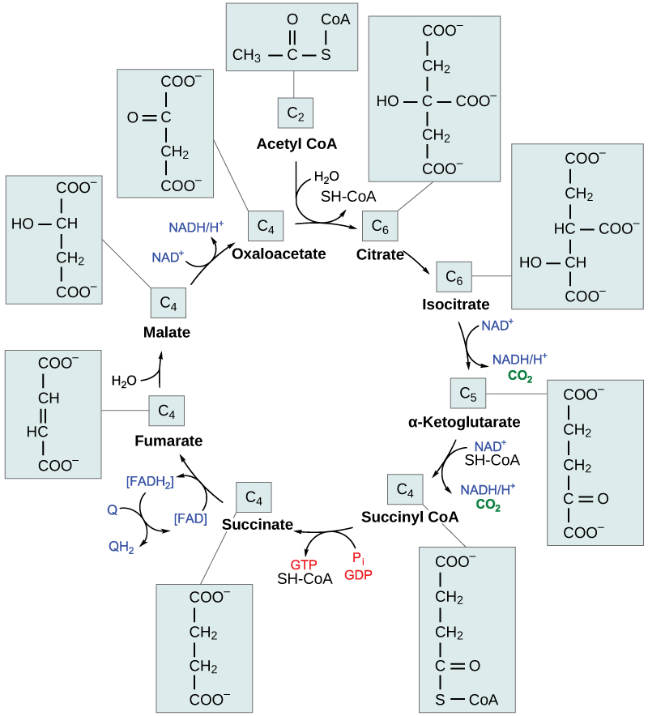
https://courses.lumenlearning.com/boundless-microbiology/chapter/the-citric-acid-krebs-cycle/
Notes:
Where does the NADH come from
Krebs cycle
Energy sources
Glycolysis
Rapoport-Leubring shunt: “wastes” high energy PO4- bond; produces 2-3DPG
Fatty acids
Ketogenic
Glucogenic
Ketone bodies
Gluconeogenesis
Glycogenesis/Glycogenolysis
TAG

Slide 40
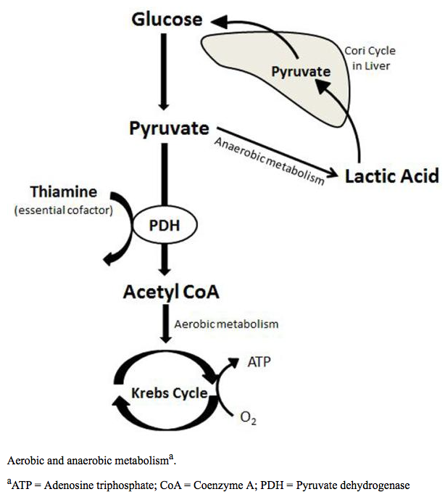

Slide 41
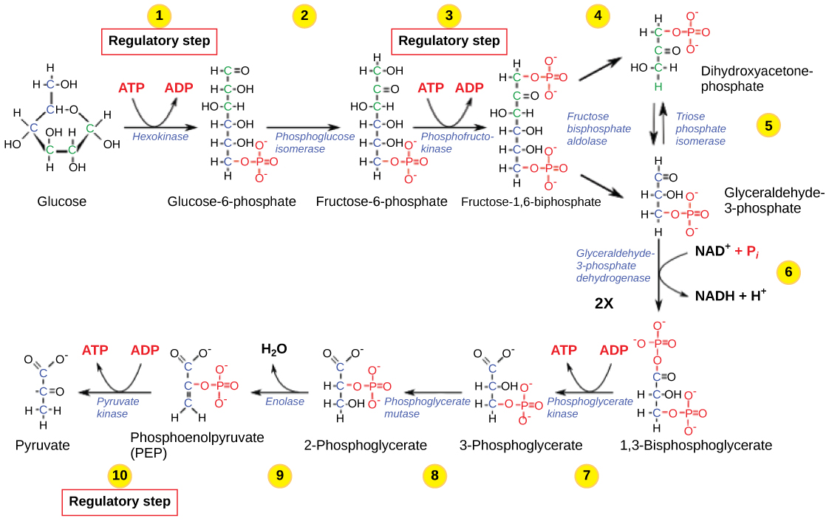
https://opentextbc.ca/biology2eopenstax/chapter/regulation-of-cellular-respiration/

Slide 42
Rapoport-Luebering Shunt?

Slide 43
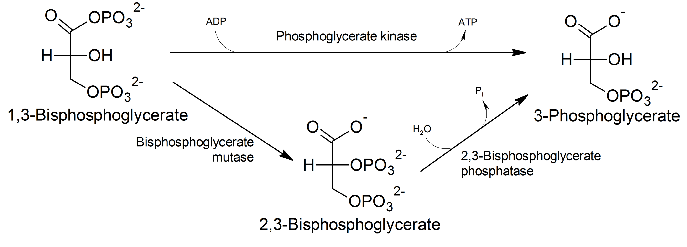
https://en.wikipedia.org/wiki/Luebering–Rapoport_pathway
Notes:
What do you notice about it?
Uses ATP. Why waste? ATP
2,3-DPG
Only present in RBC’s

Slide 44
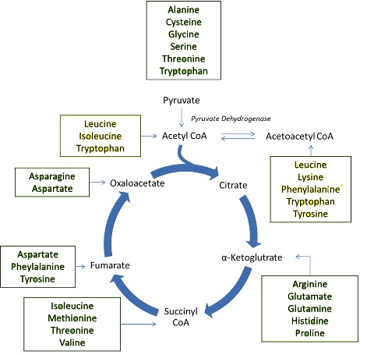

Slide 45
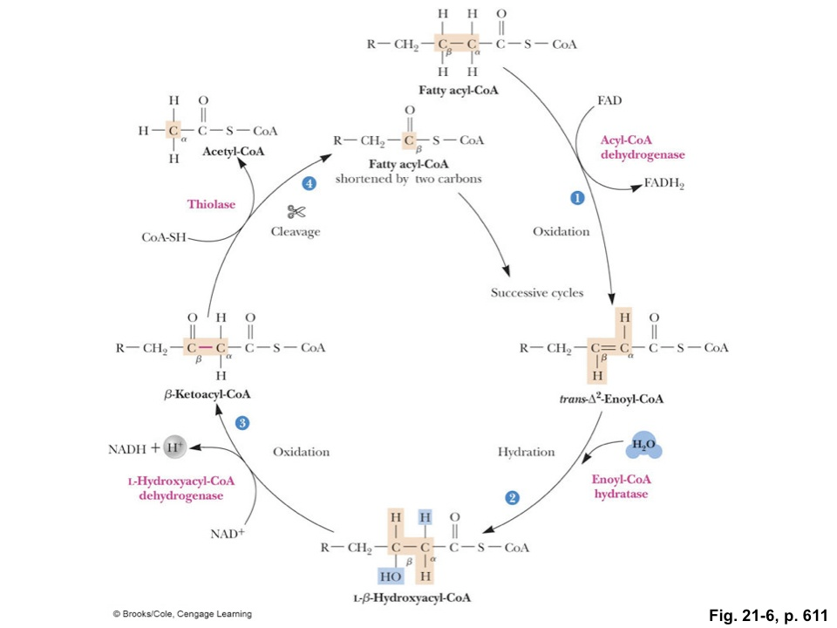

Slide 46
